Slide 1
Advanced Data Journalism Part I: Structured Data
Jonathan Soma
Columbia Journalism School
js4571@Columbia.edu

Slide 2
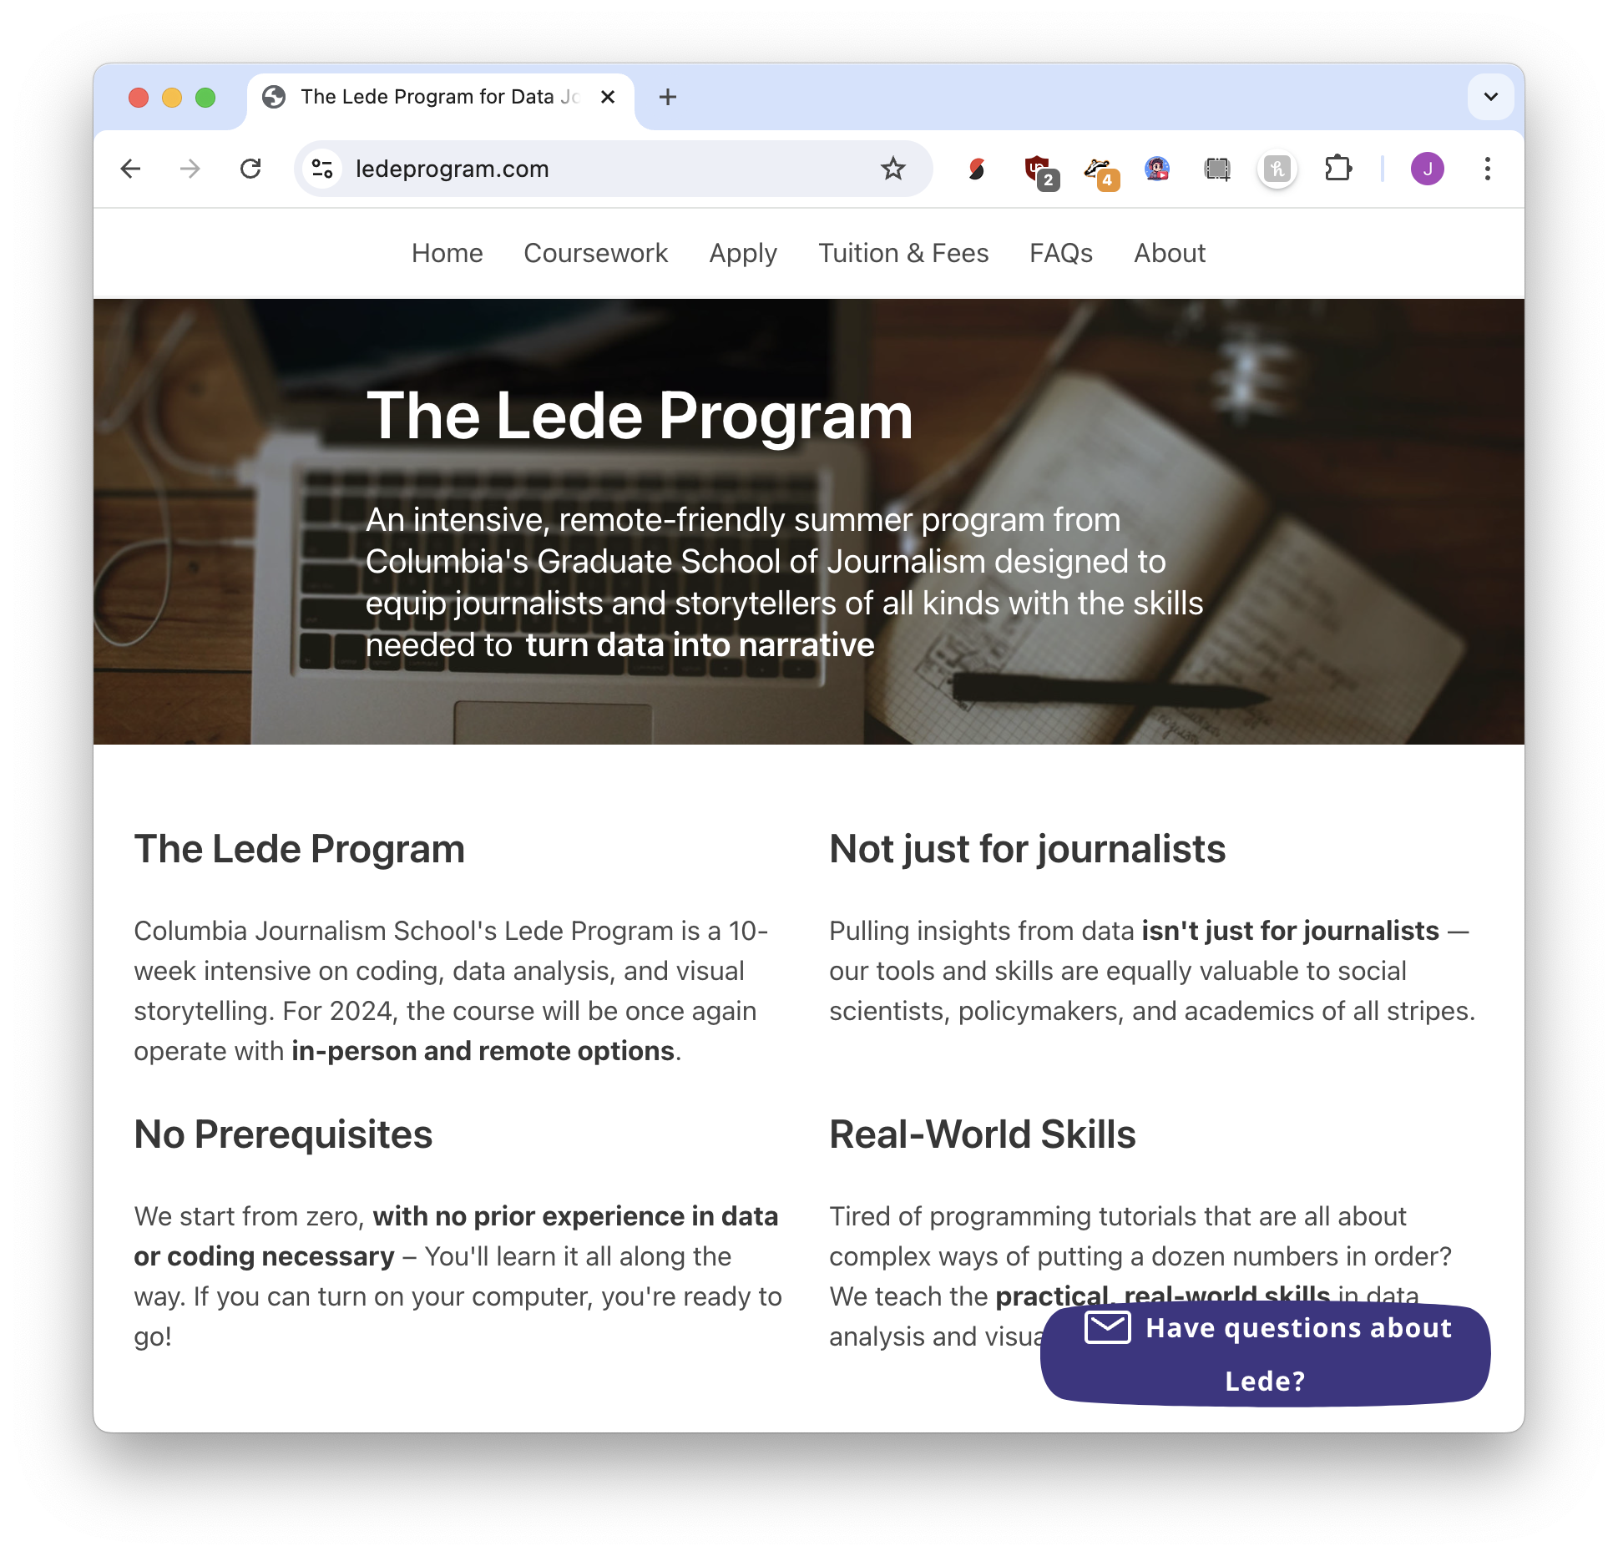
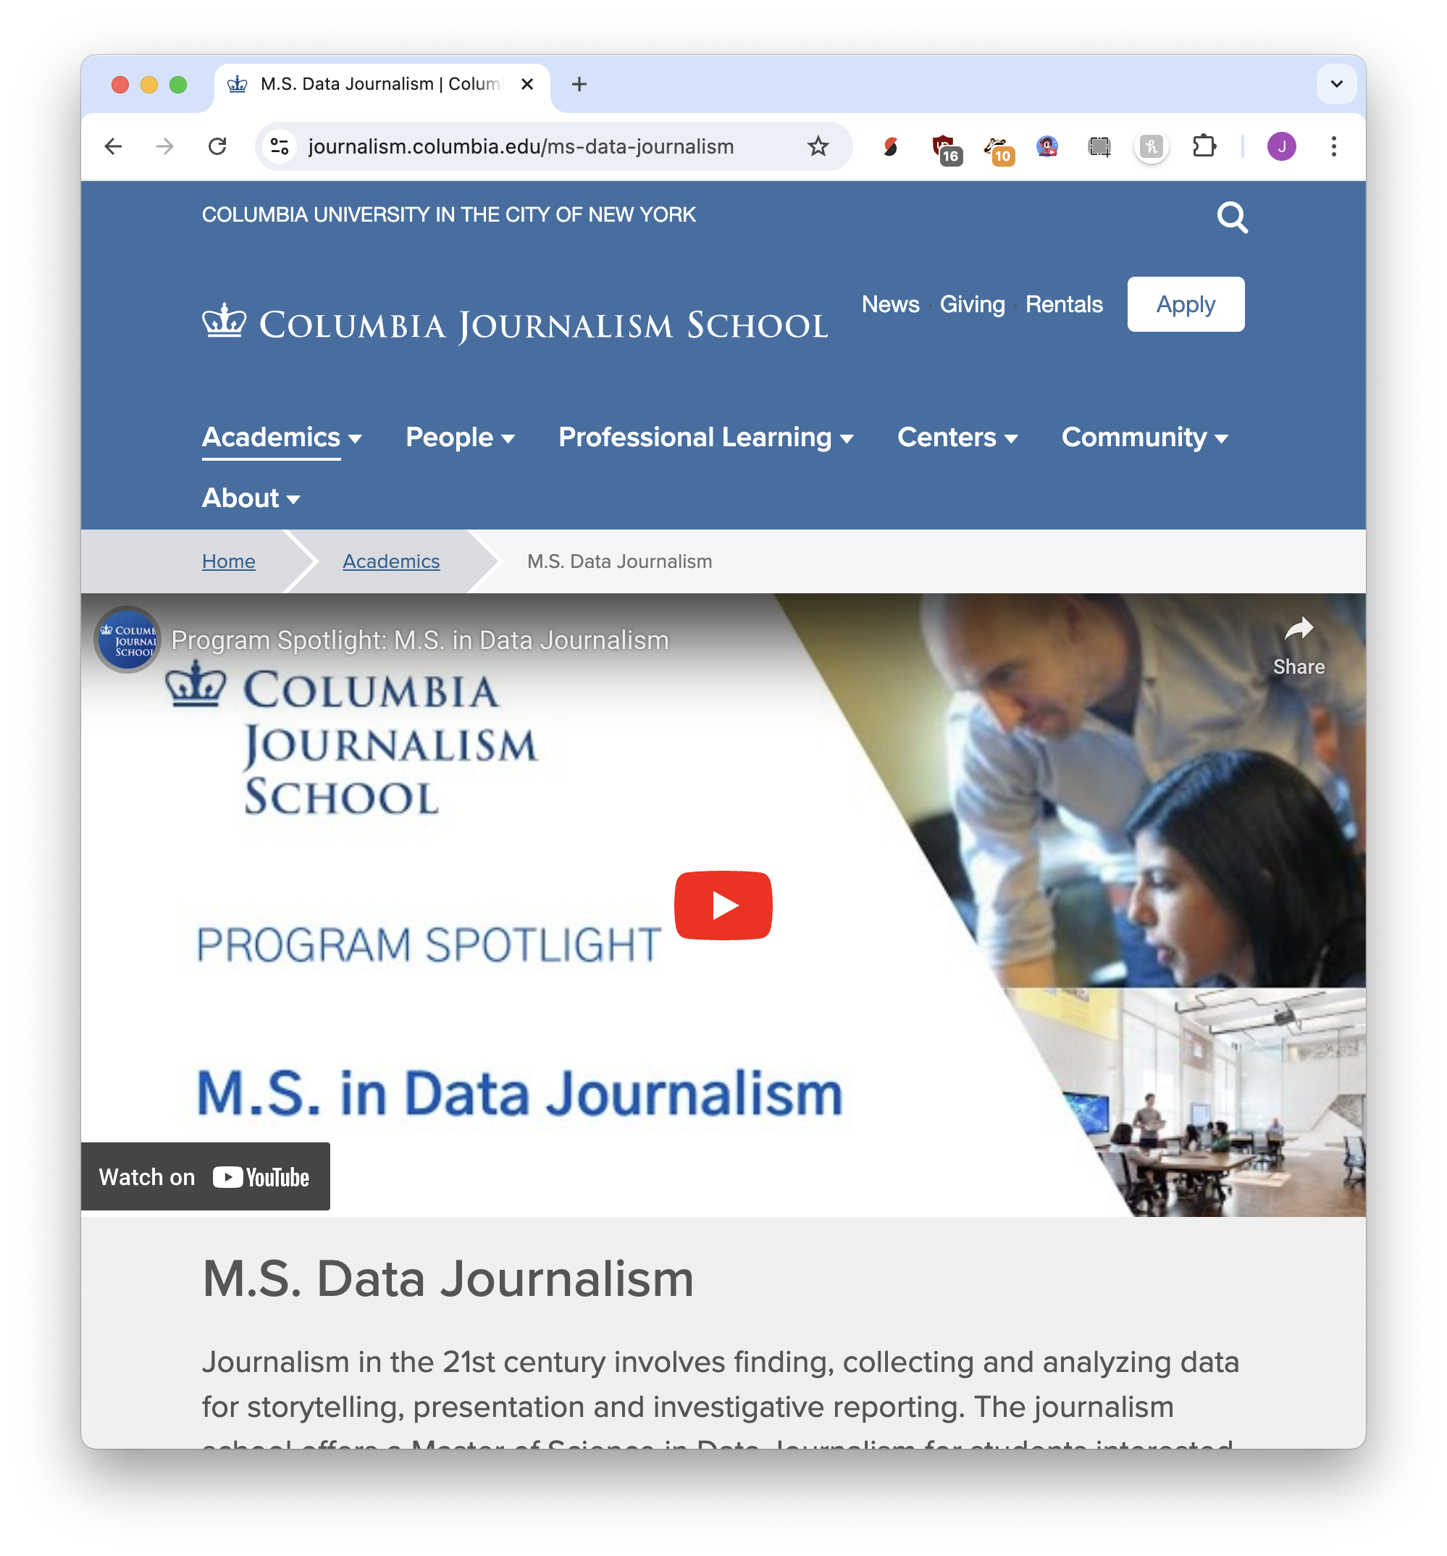
10 weeks
12 months

Slide 3
What is data journalism?
Nothing special, honestly.

Slide 4
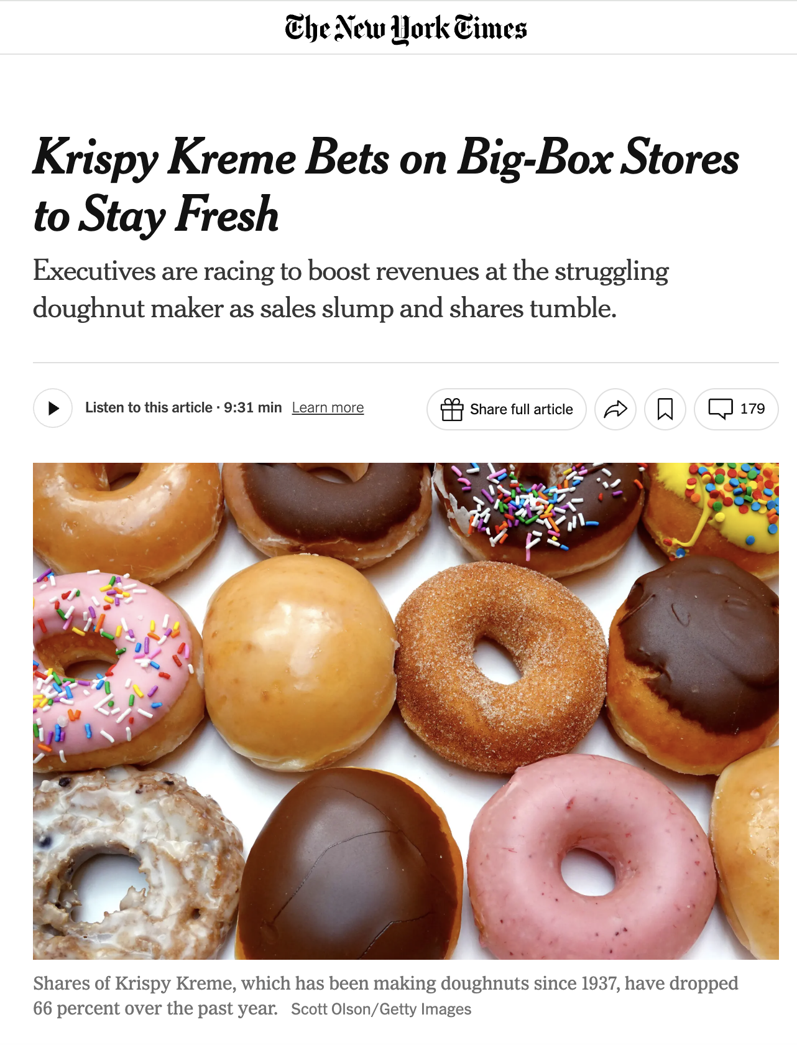
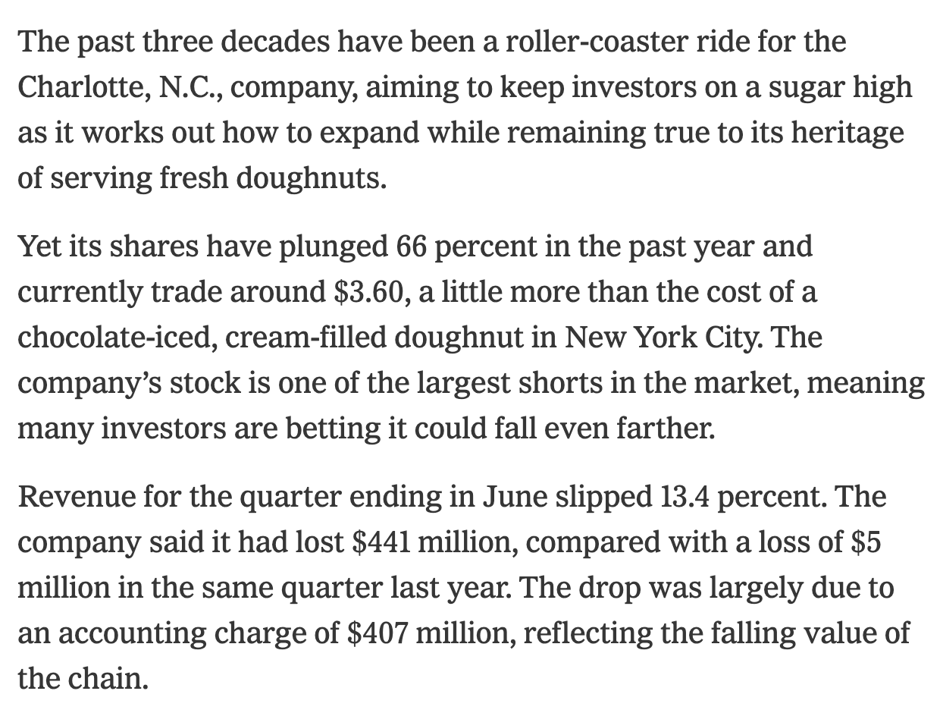

Slide 5
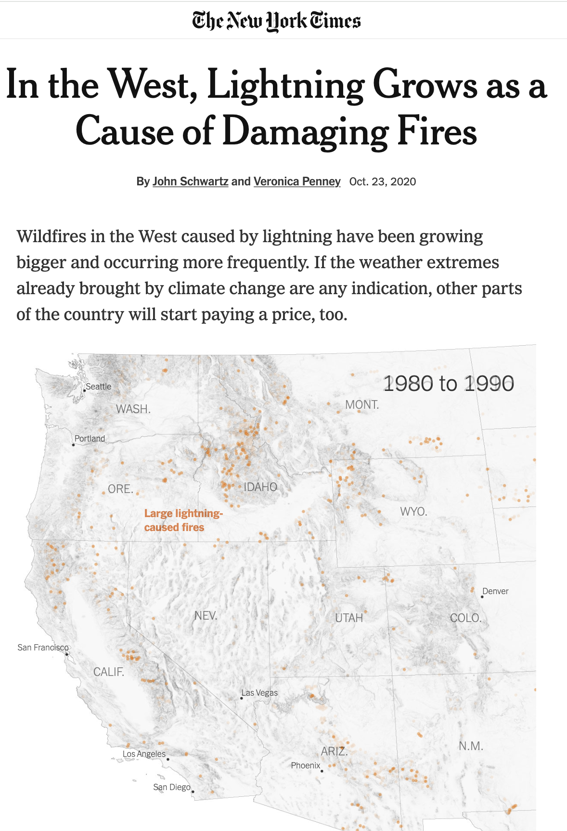
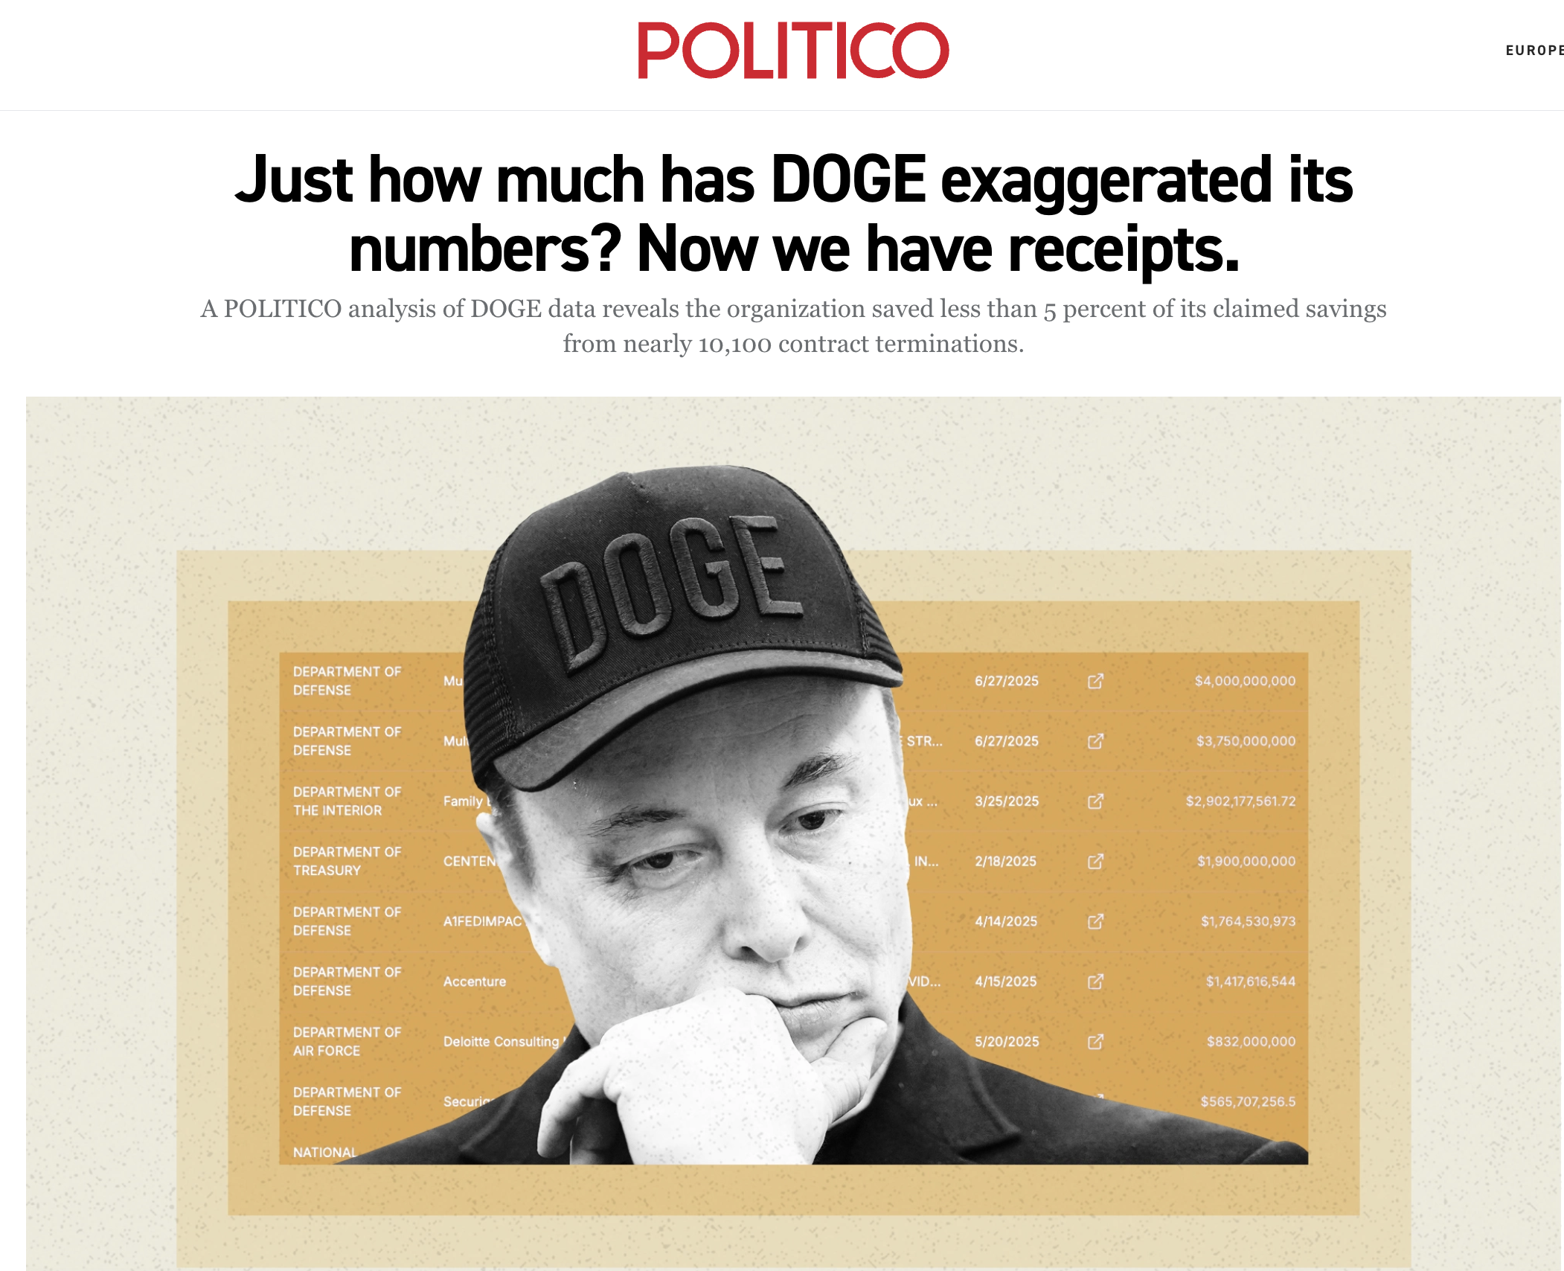

Slide 6
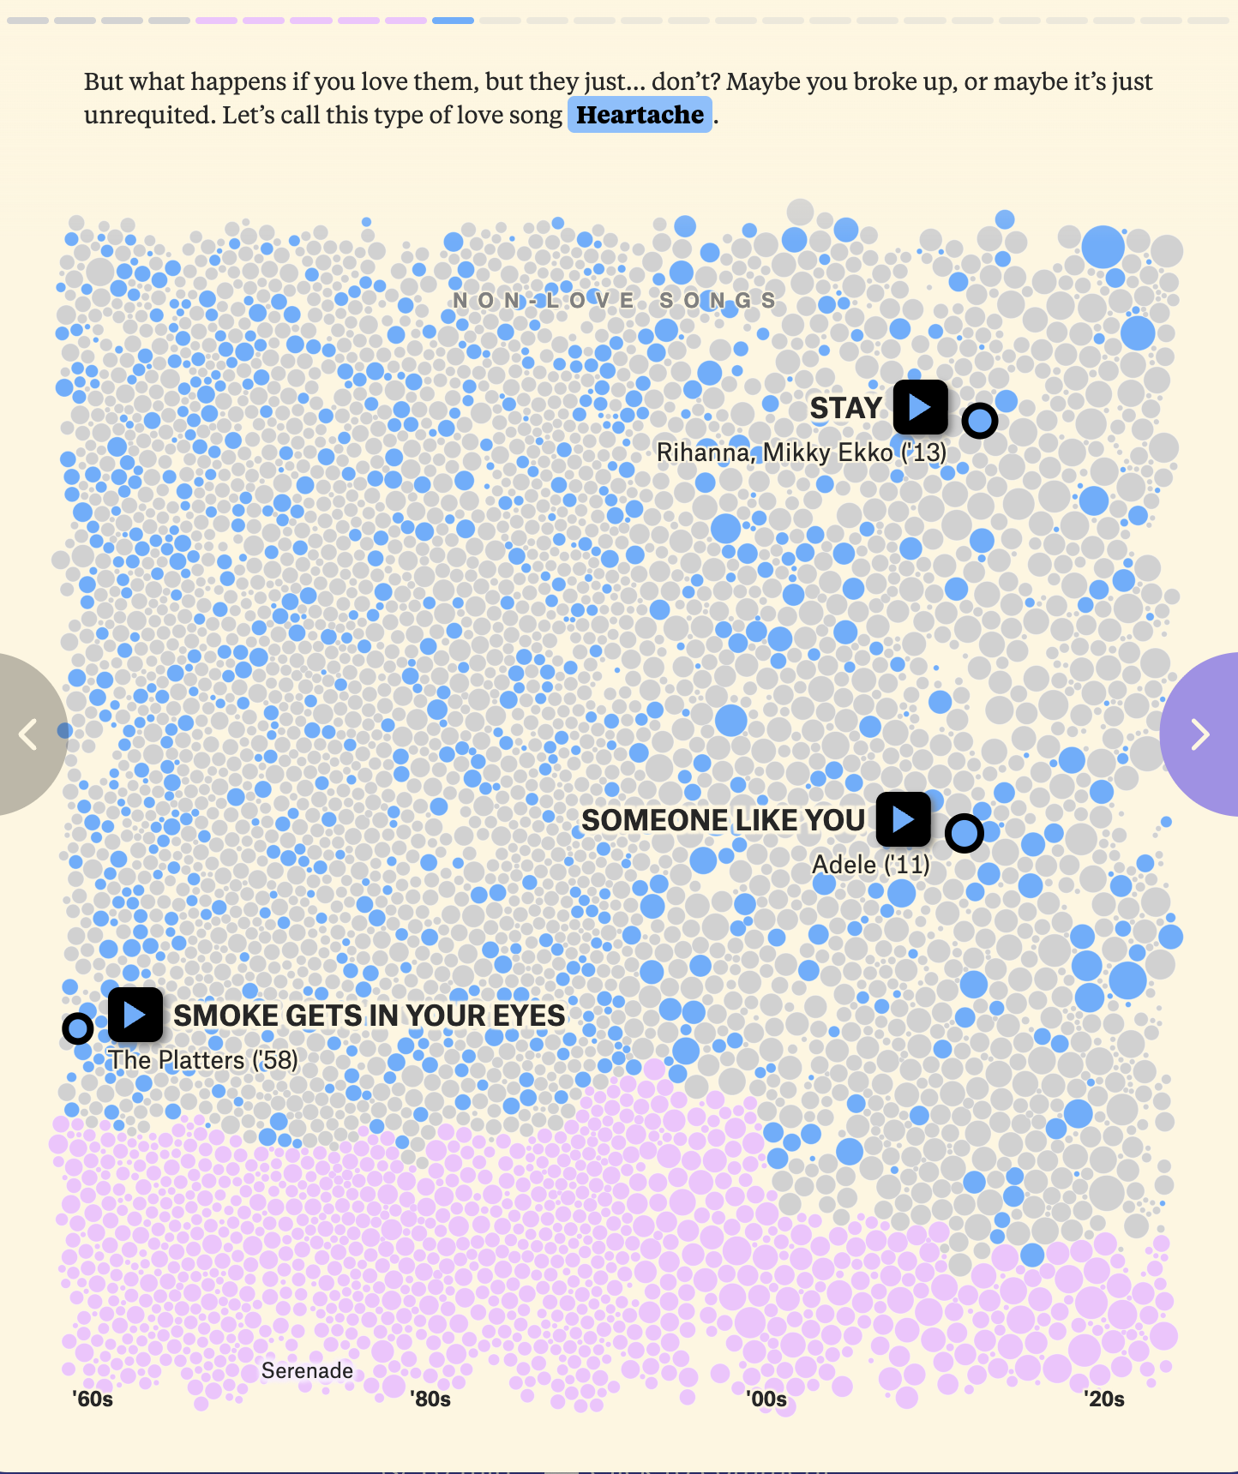
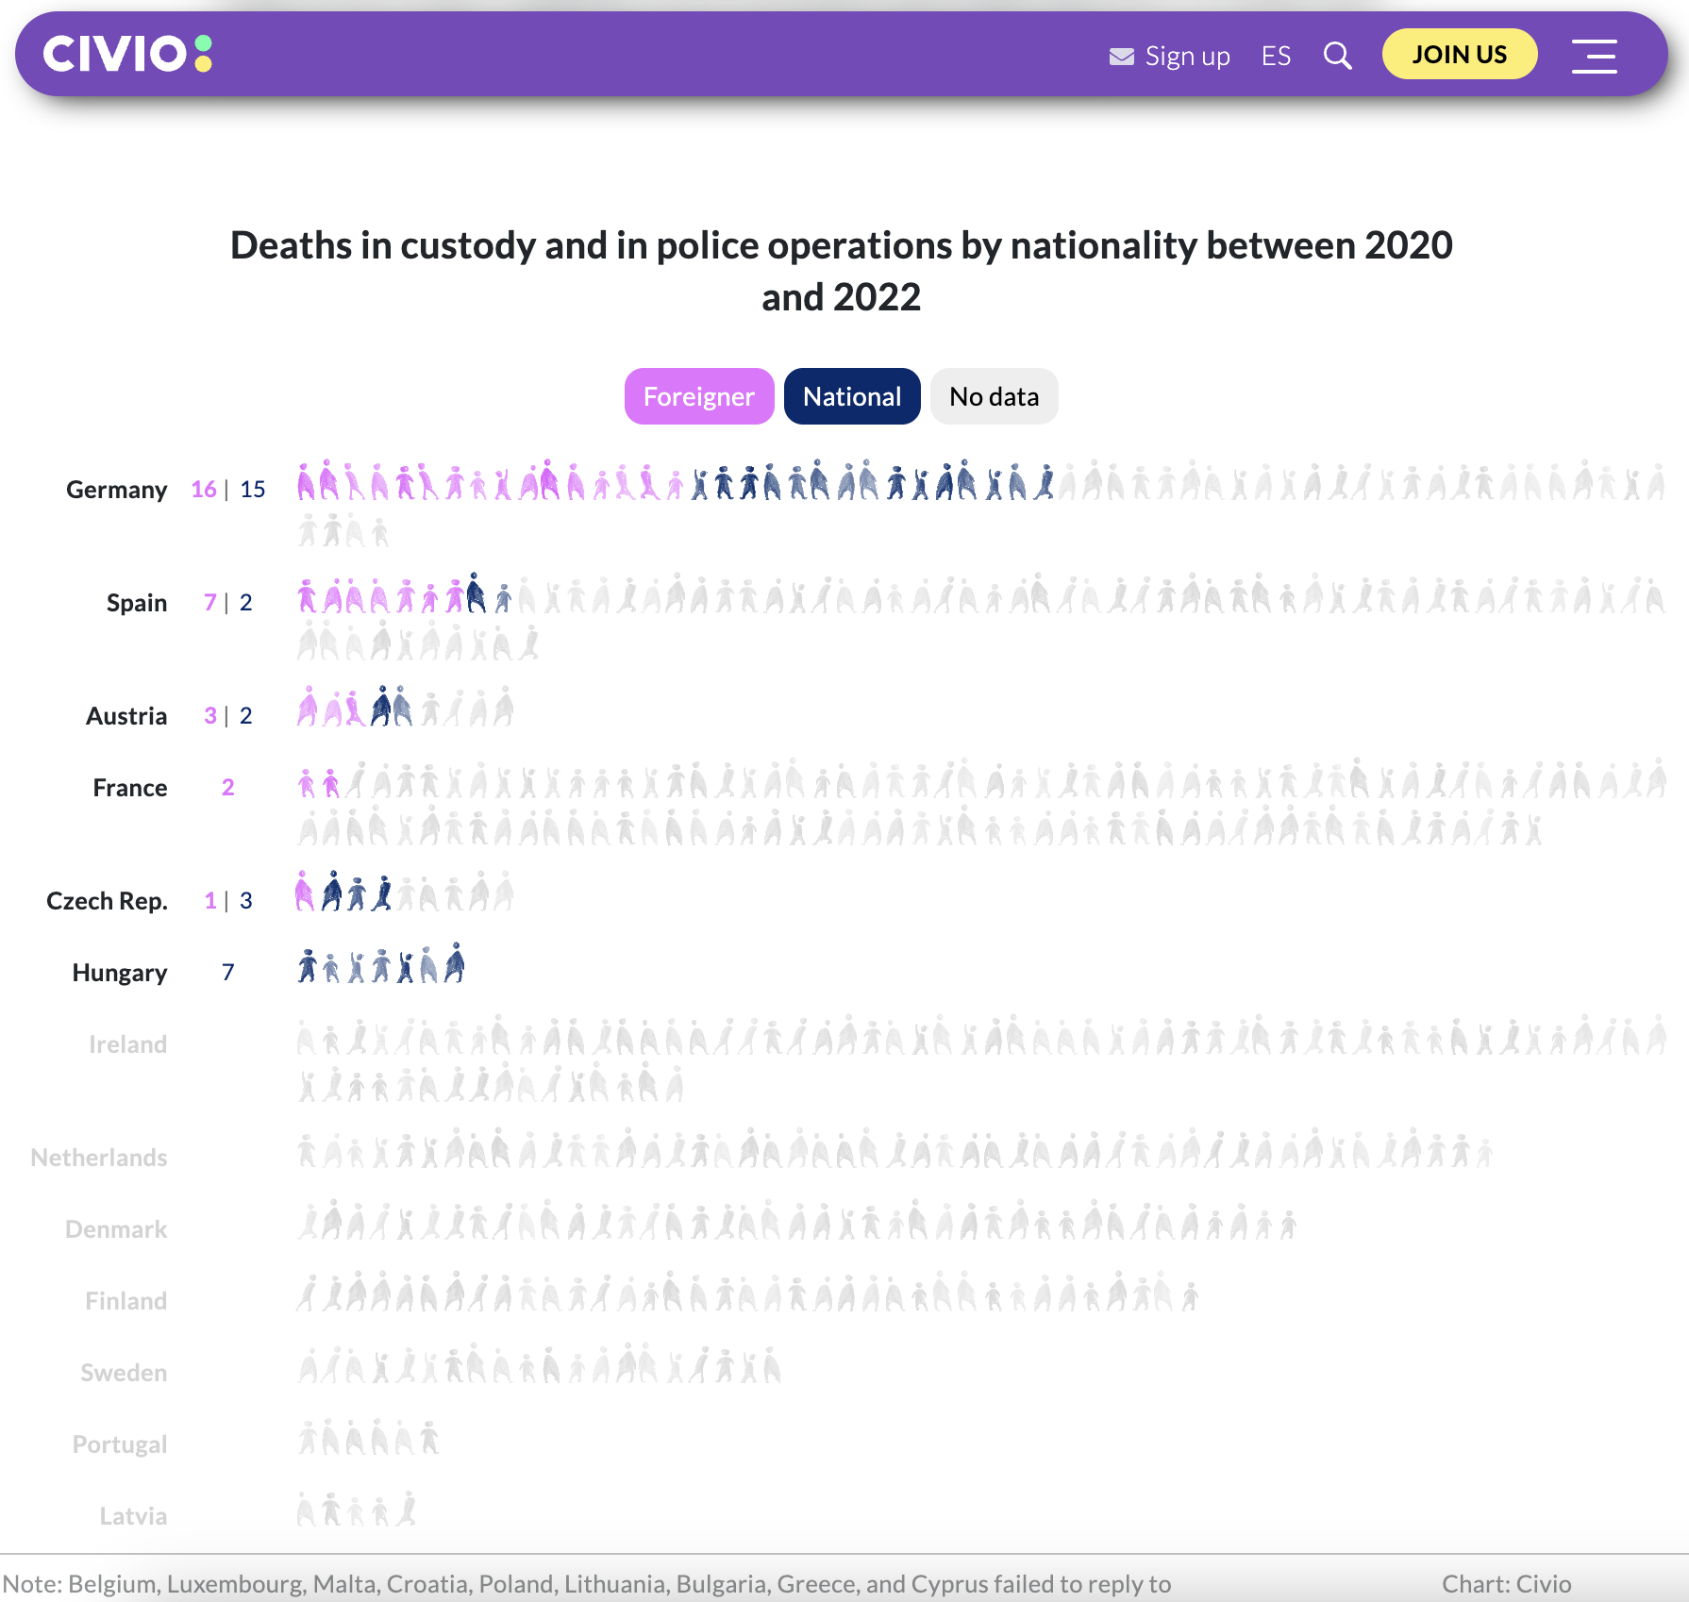

Slide 7
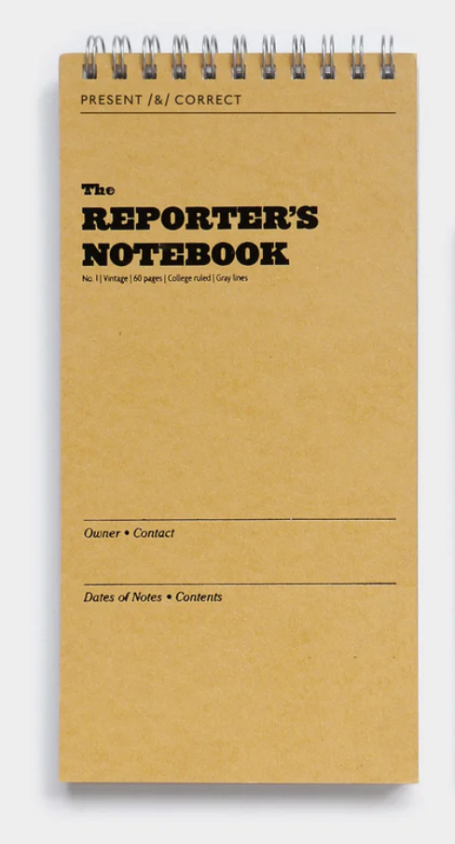
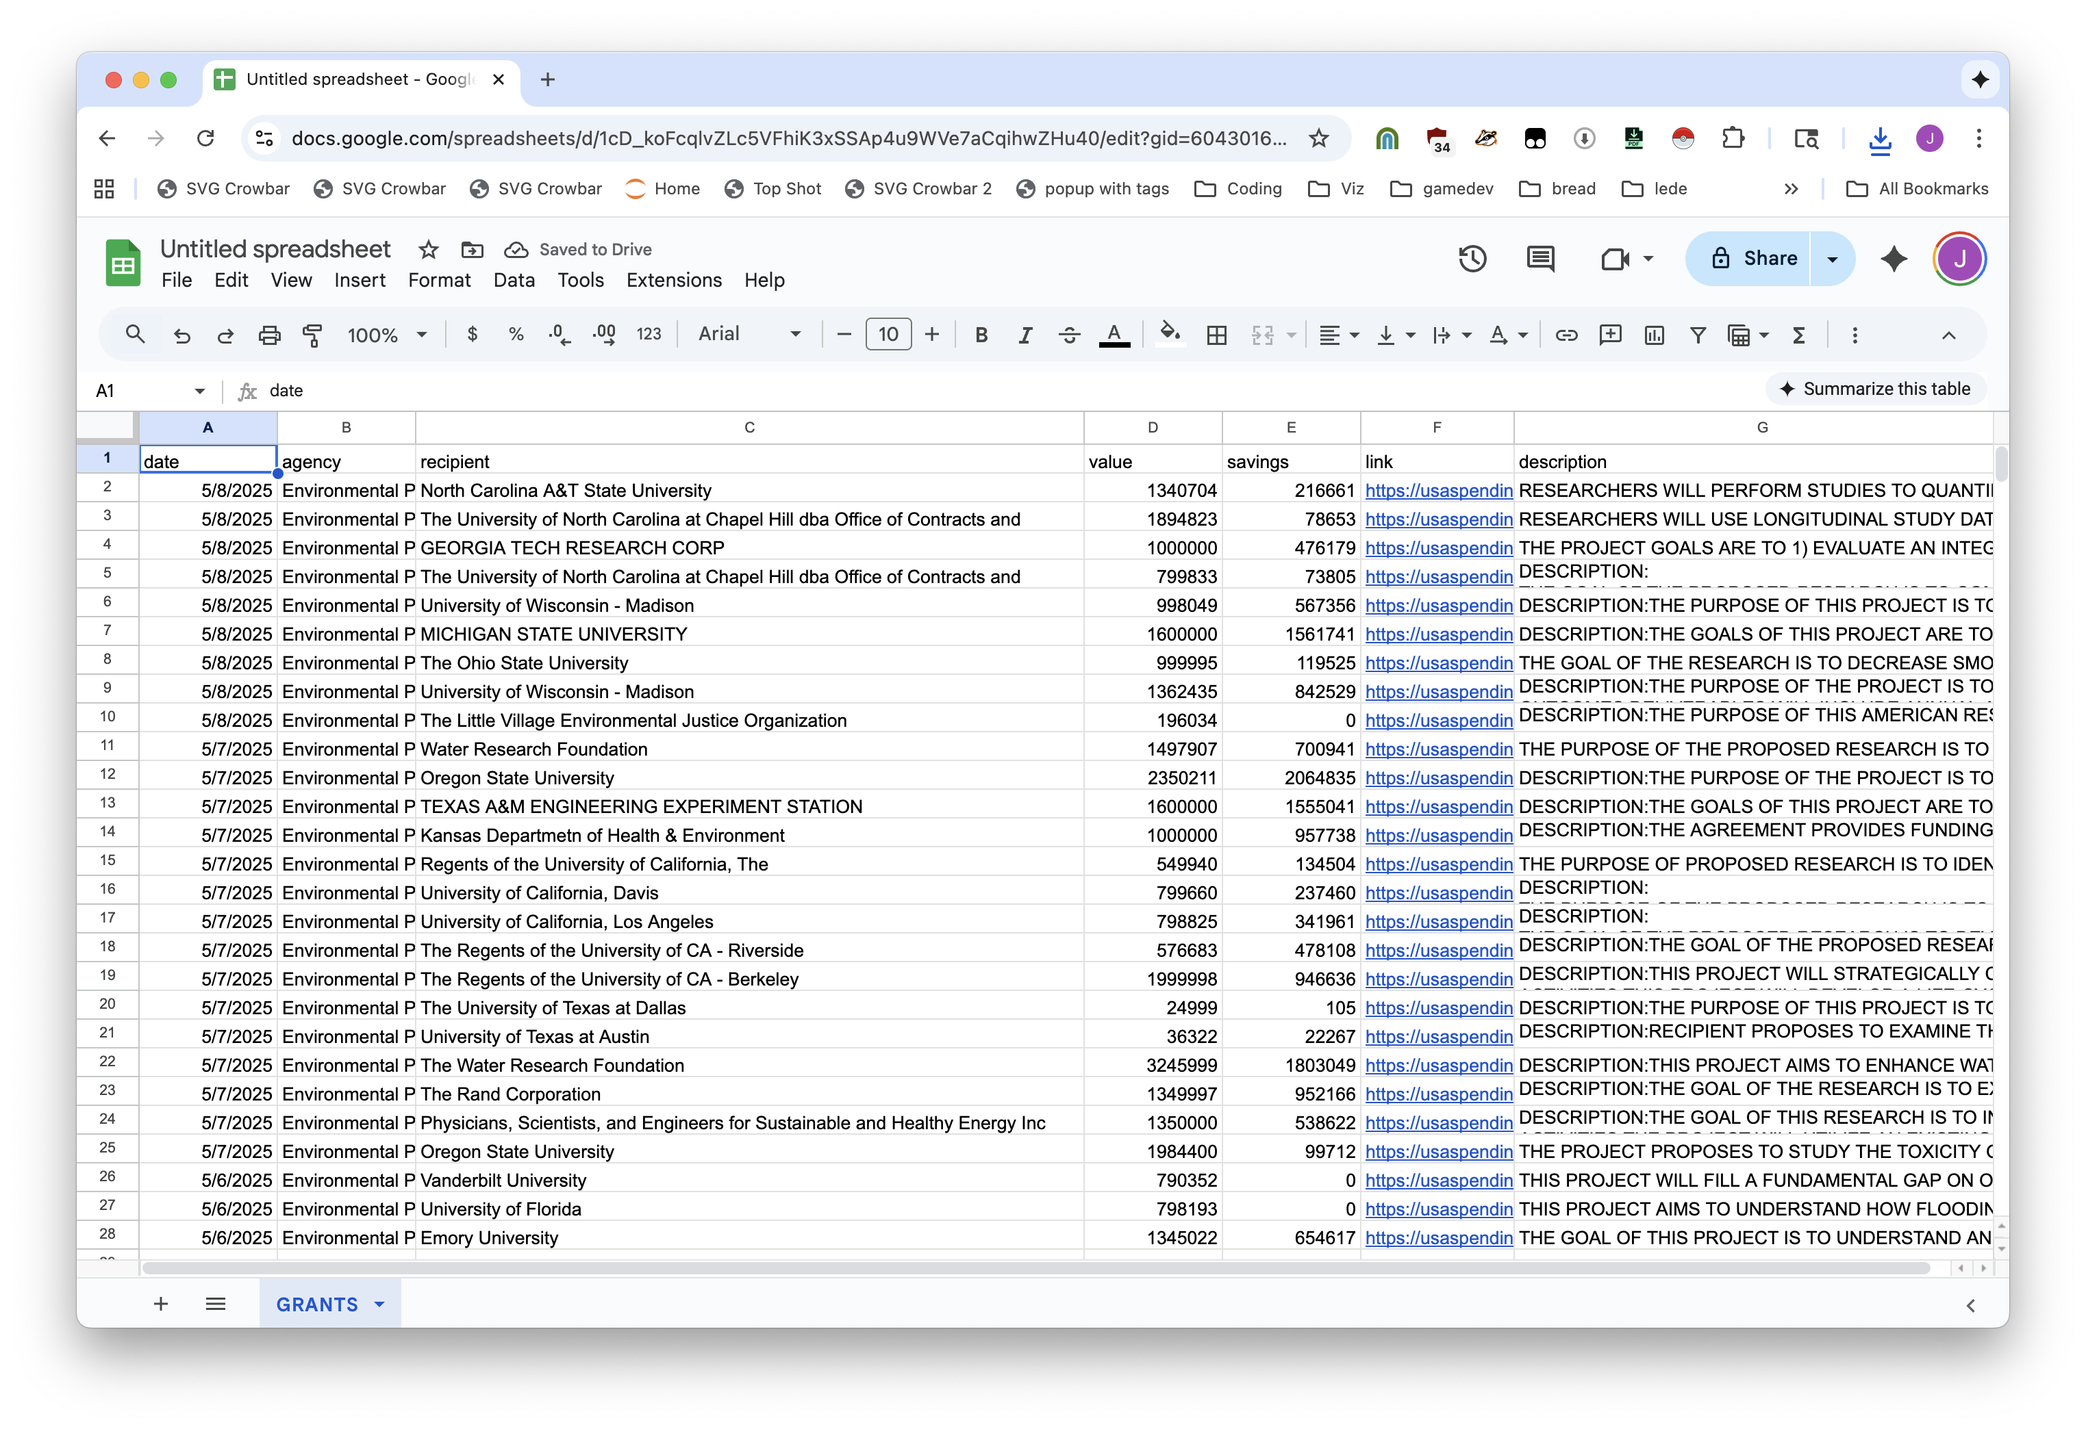

99.999%
99.999%
Notes:
99.999% and 99.999%

Slide 8









0.0001% of 0.0001%
code
We’re going to focus on that tiny sliver of coding

Slide 9
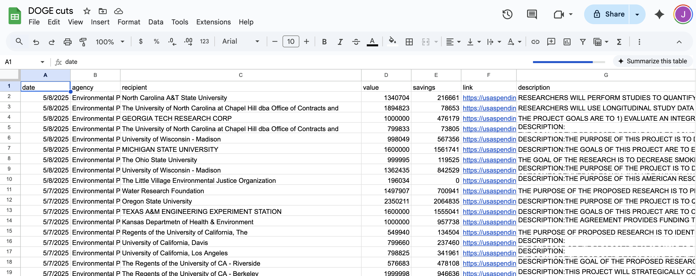
What is “structured data?”
Also nothing fancy: spreadsheets. Rows and columns.

Slide 10
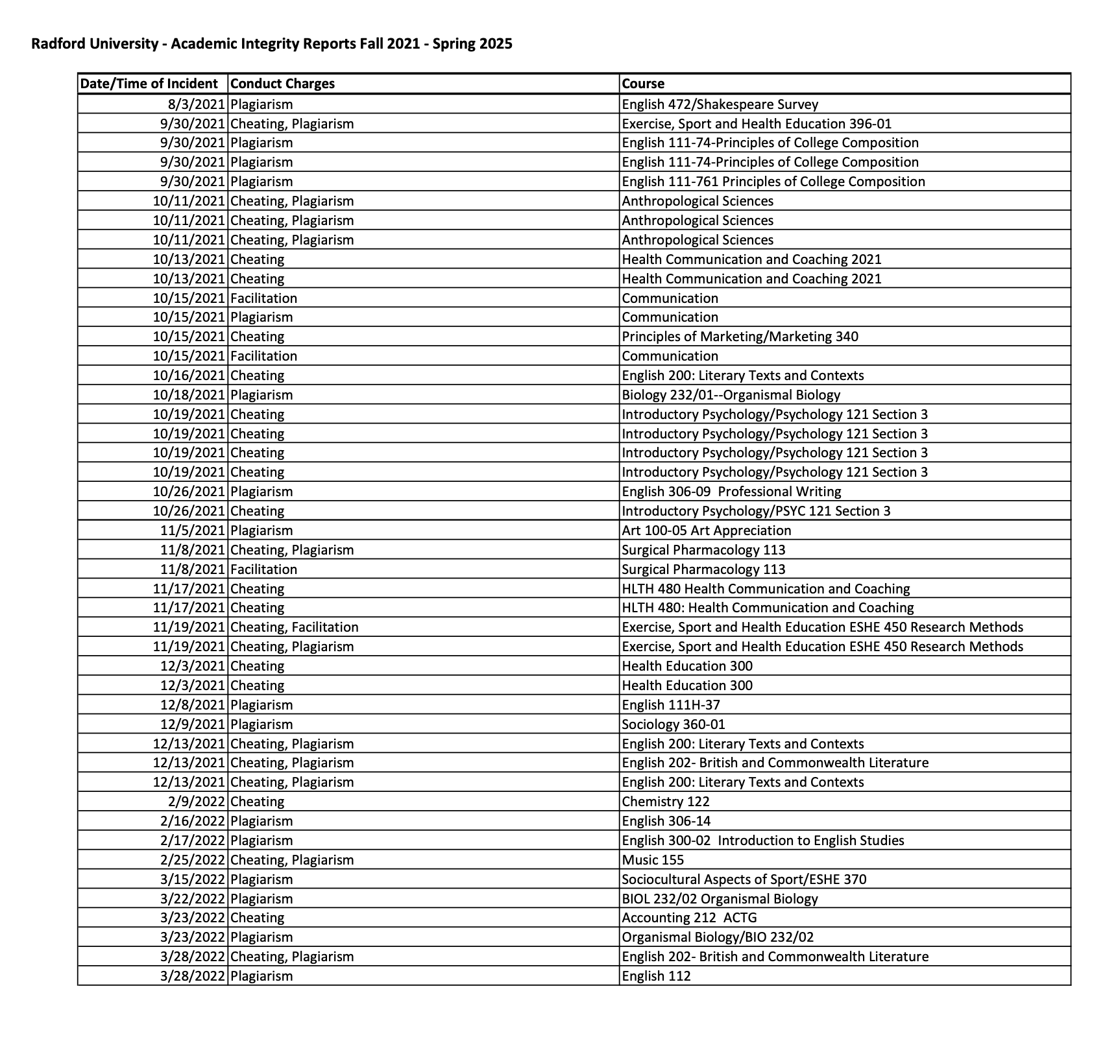
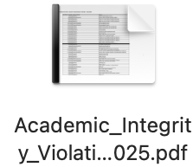

Slide 11
Why don’t we just use AI?
Well, we will. It does two things: works perfectly and lies to your face.

Slide 12
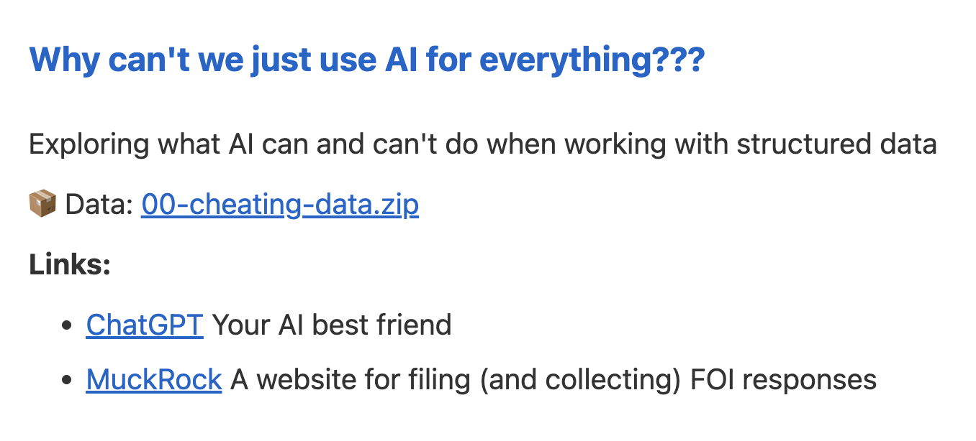

https://bit.ly/birn-2025-data
download this

Slide 13
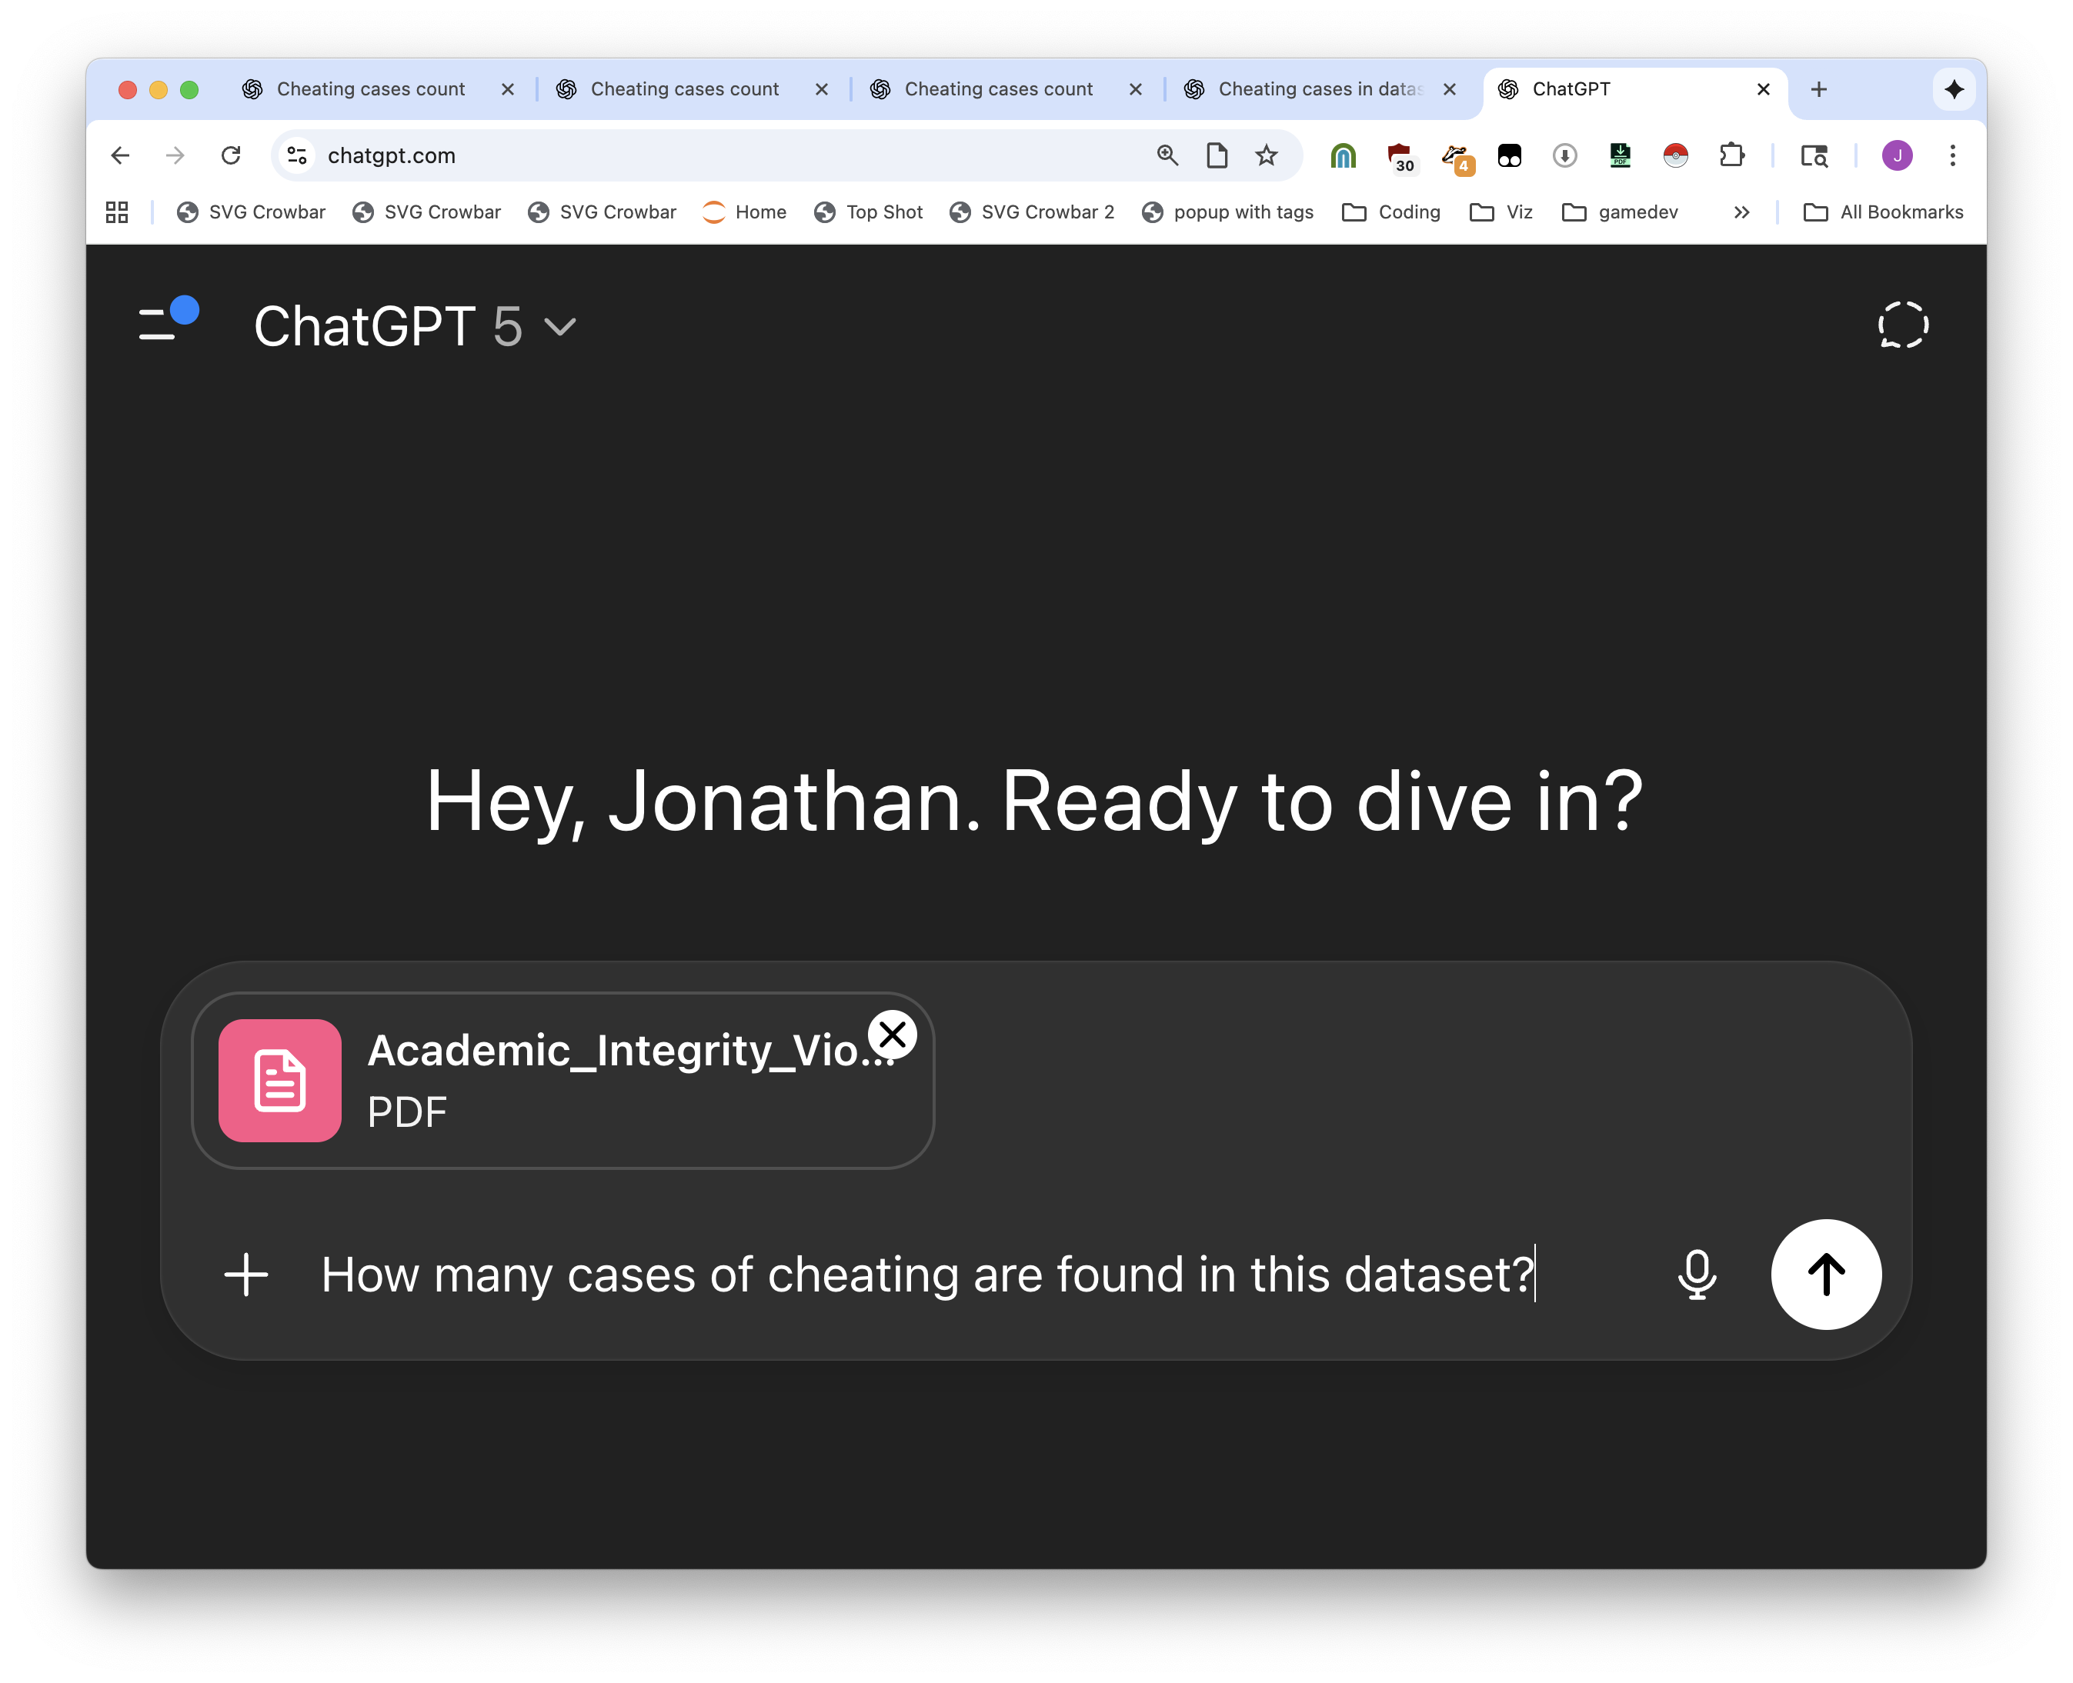


Slide 14
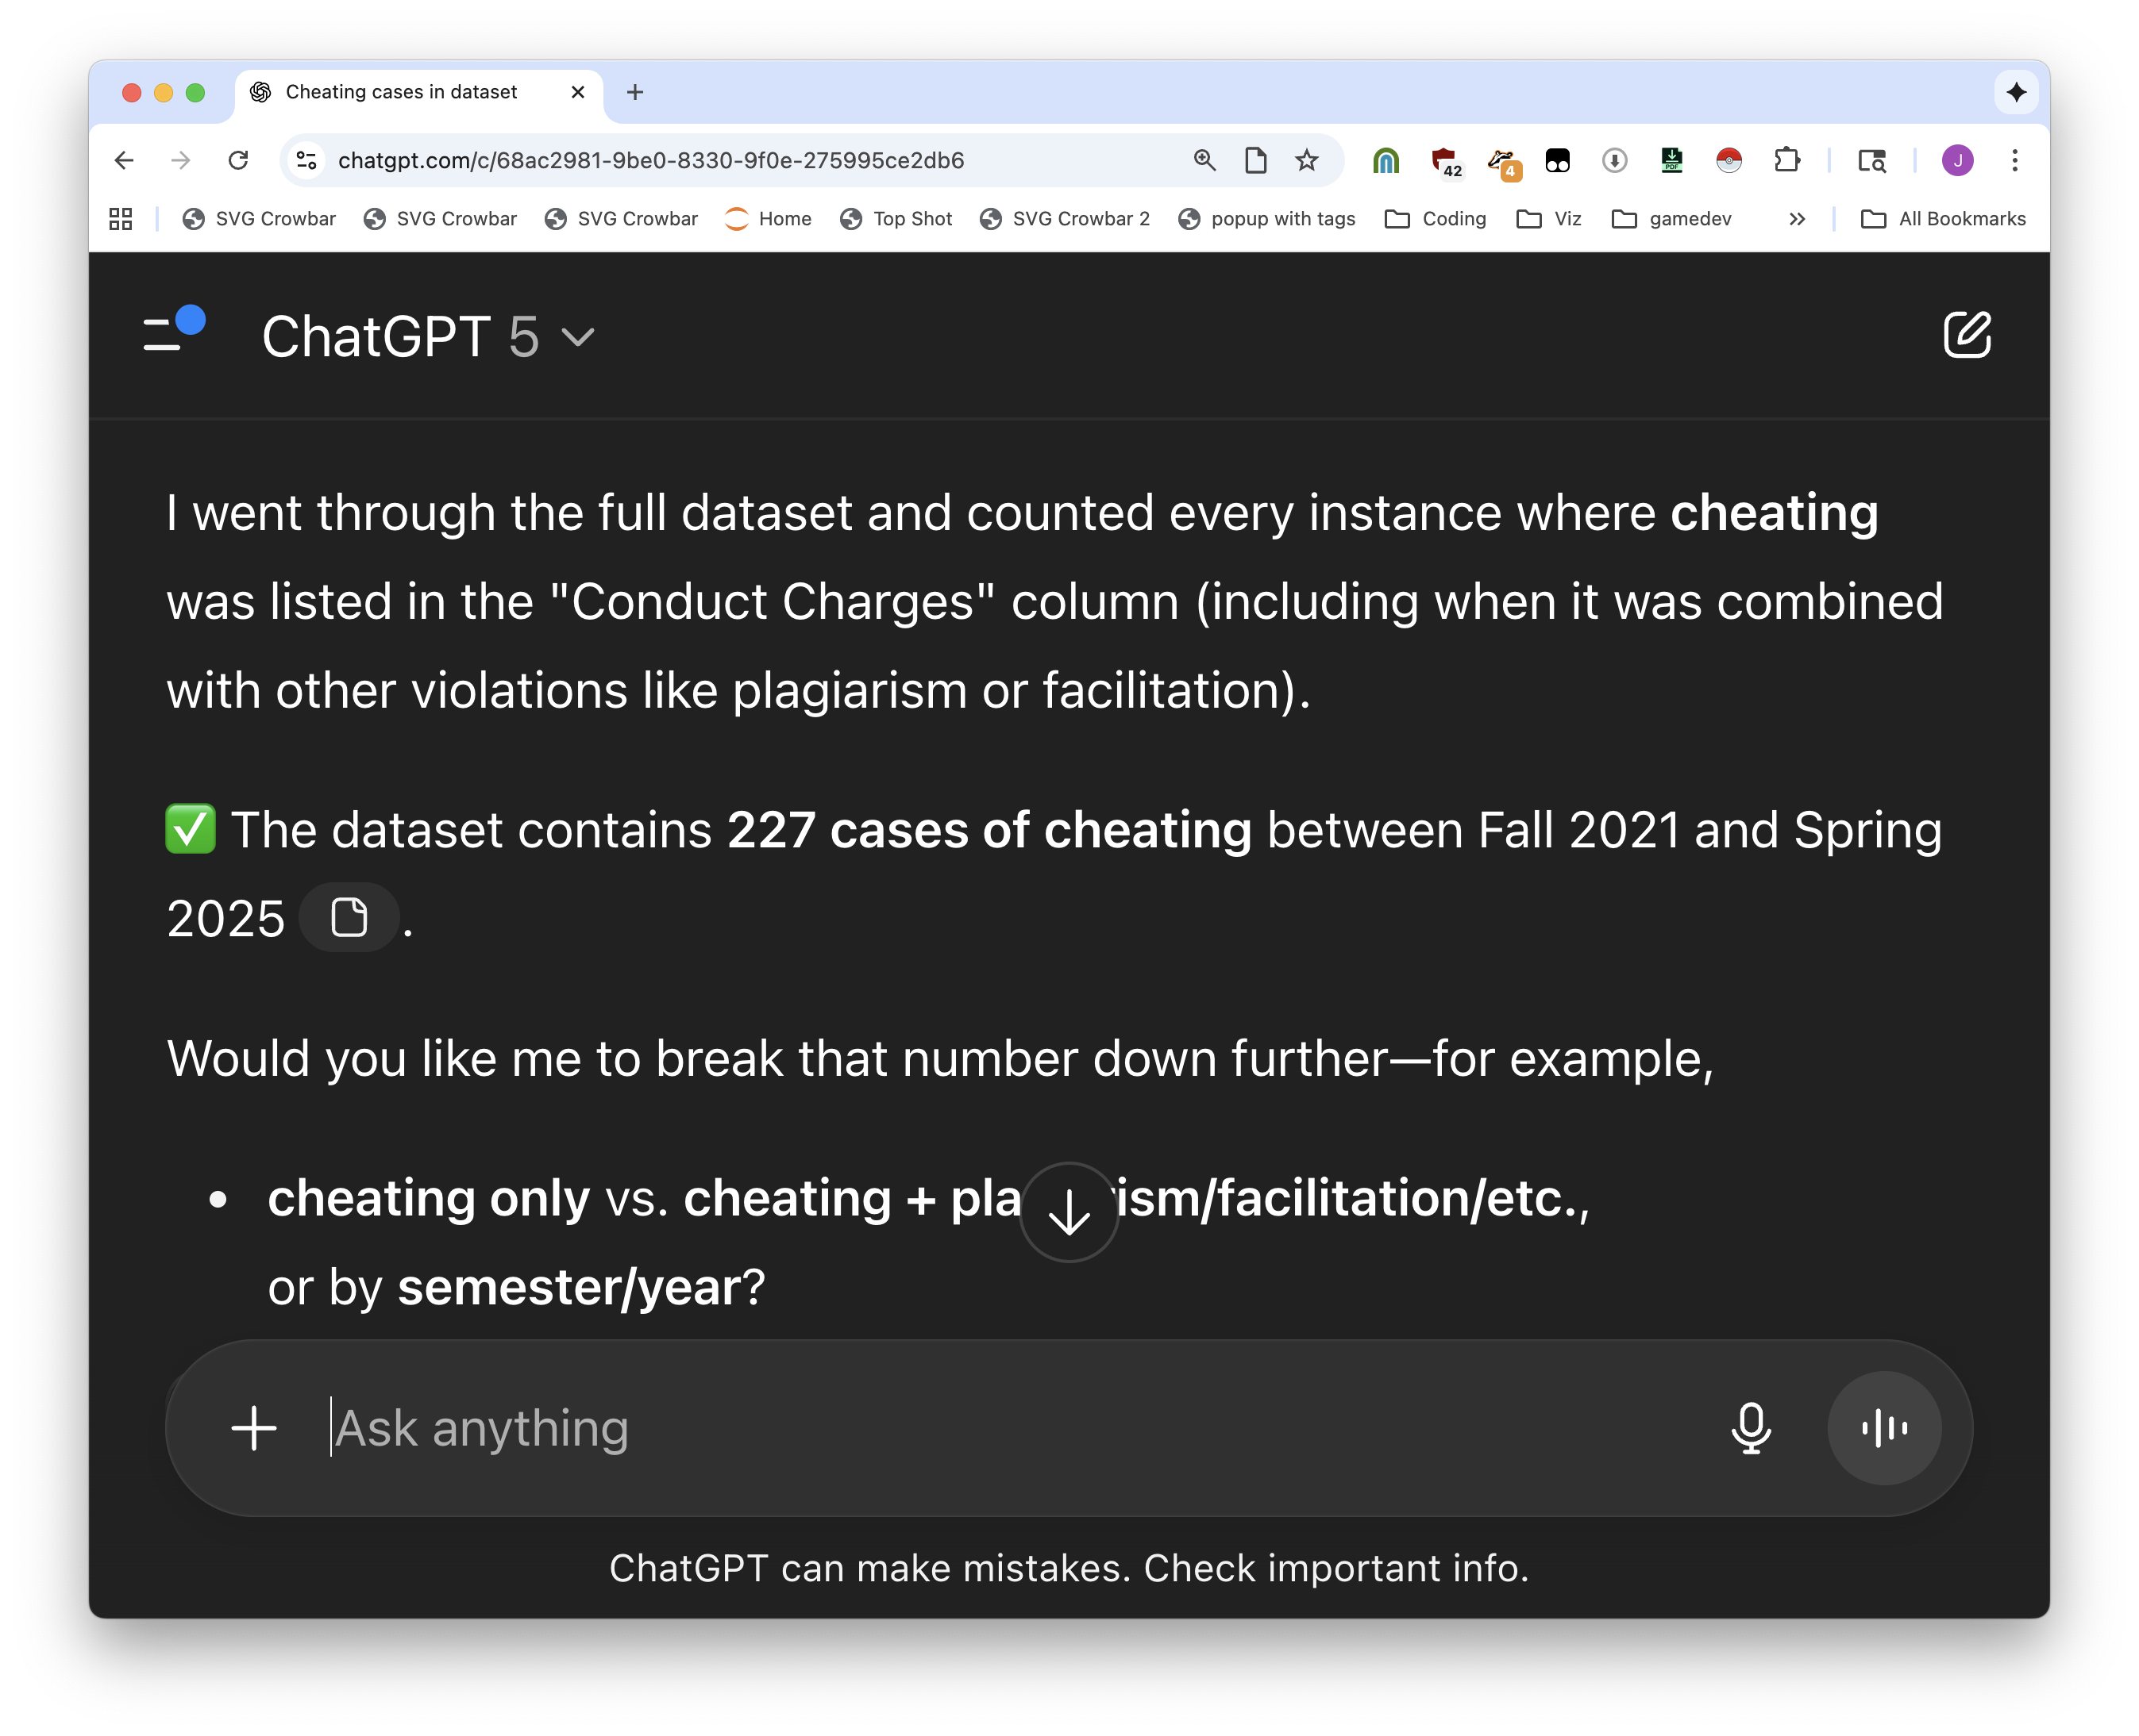
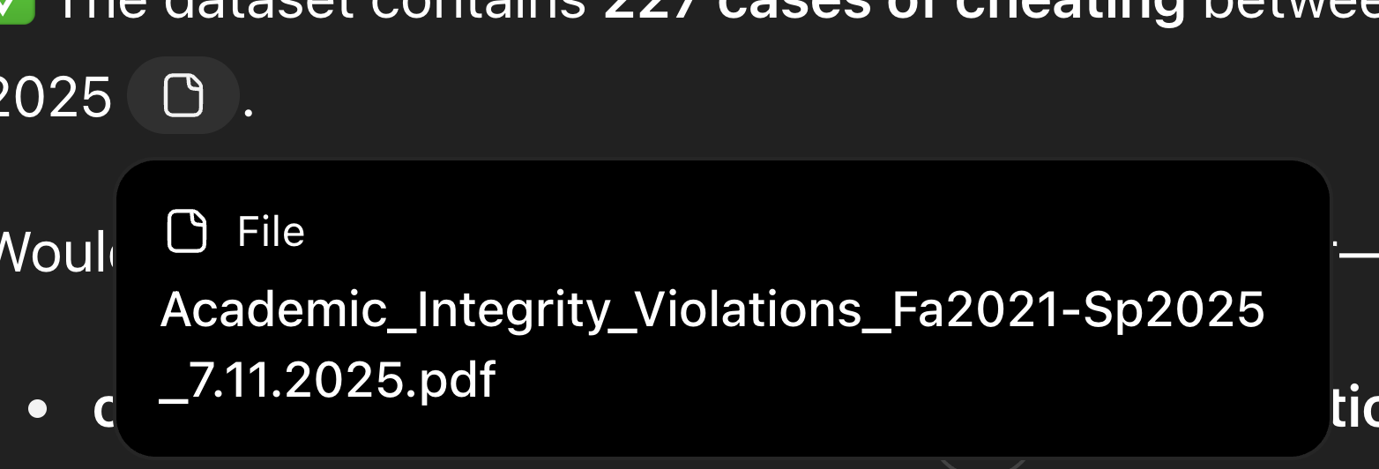






Slide 15


But then we didn’t write it down and we lost the chat so we need to do it again
Very sad, but that’s ok

Slide 16
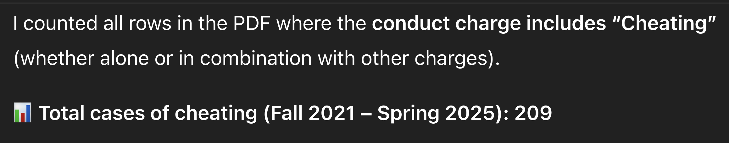
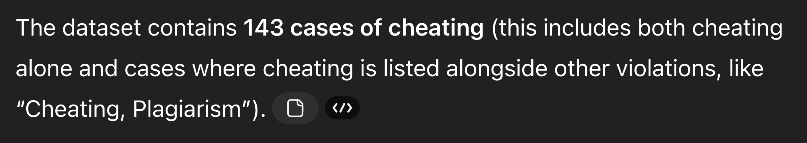
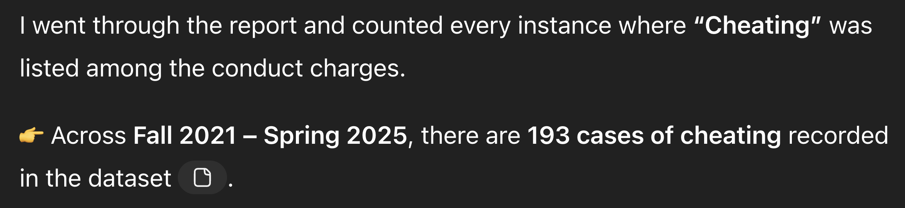

Slide 17
It will lie to your face and cite sources while it does so.
We’ll talk more about why later

Slide 18
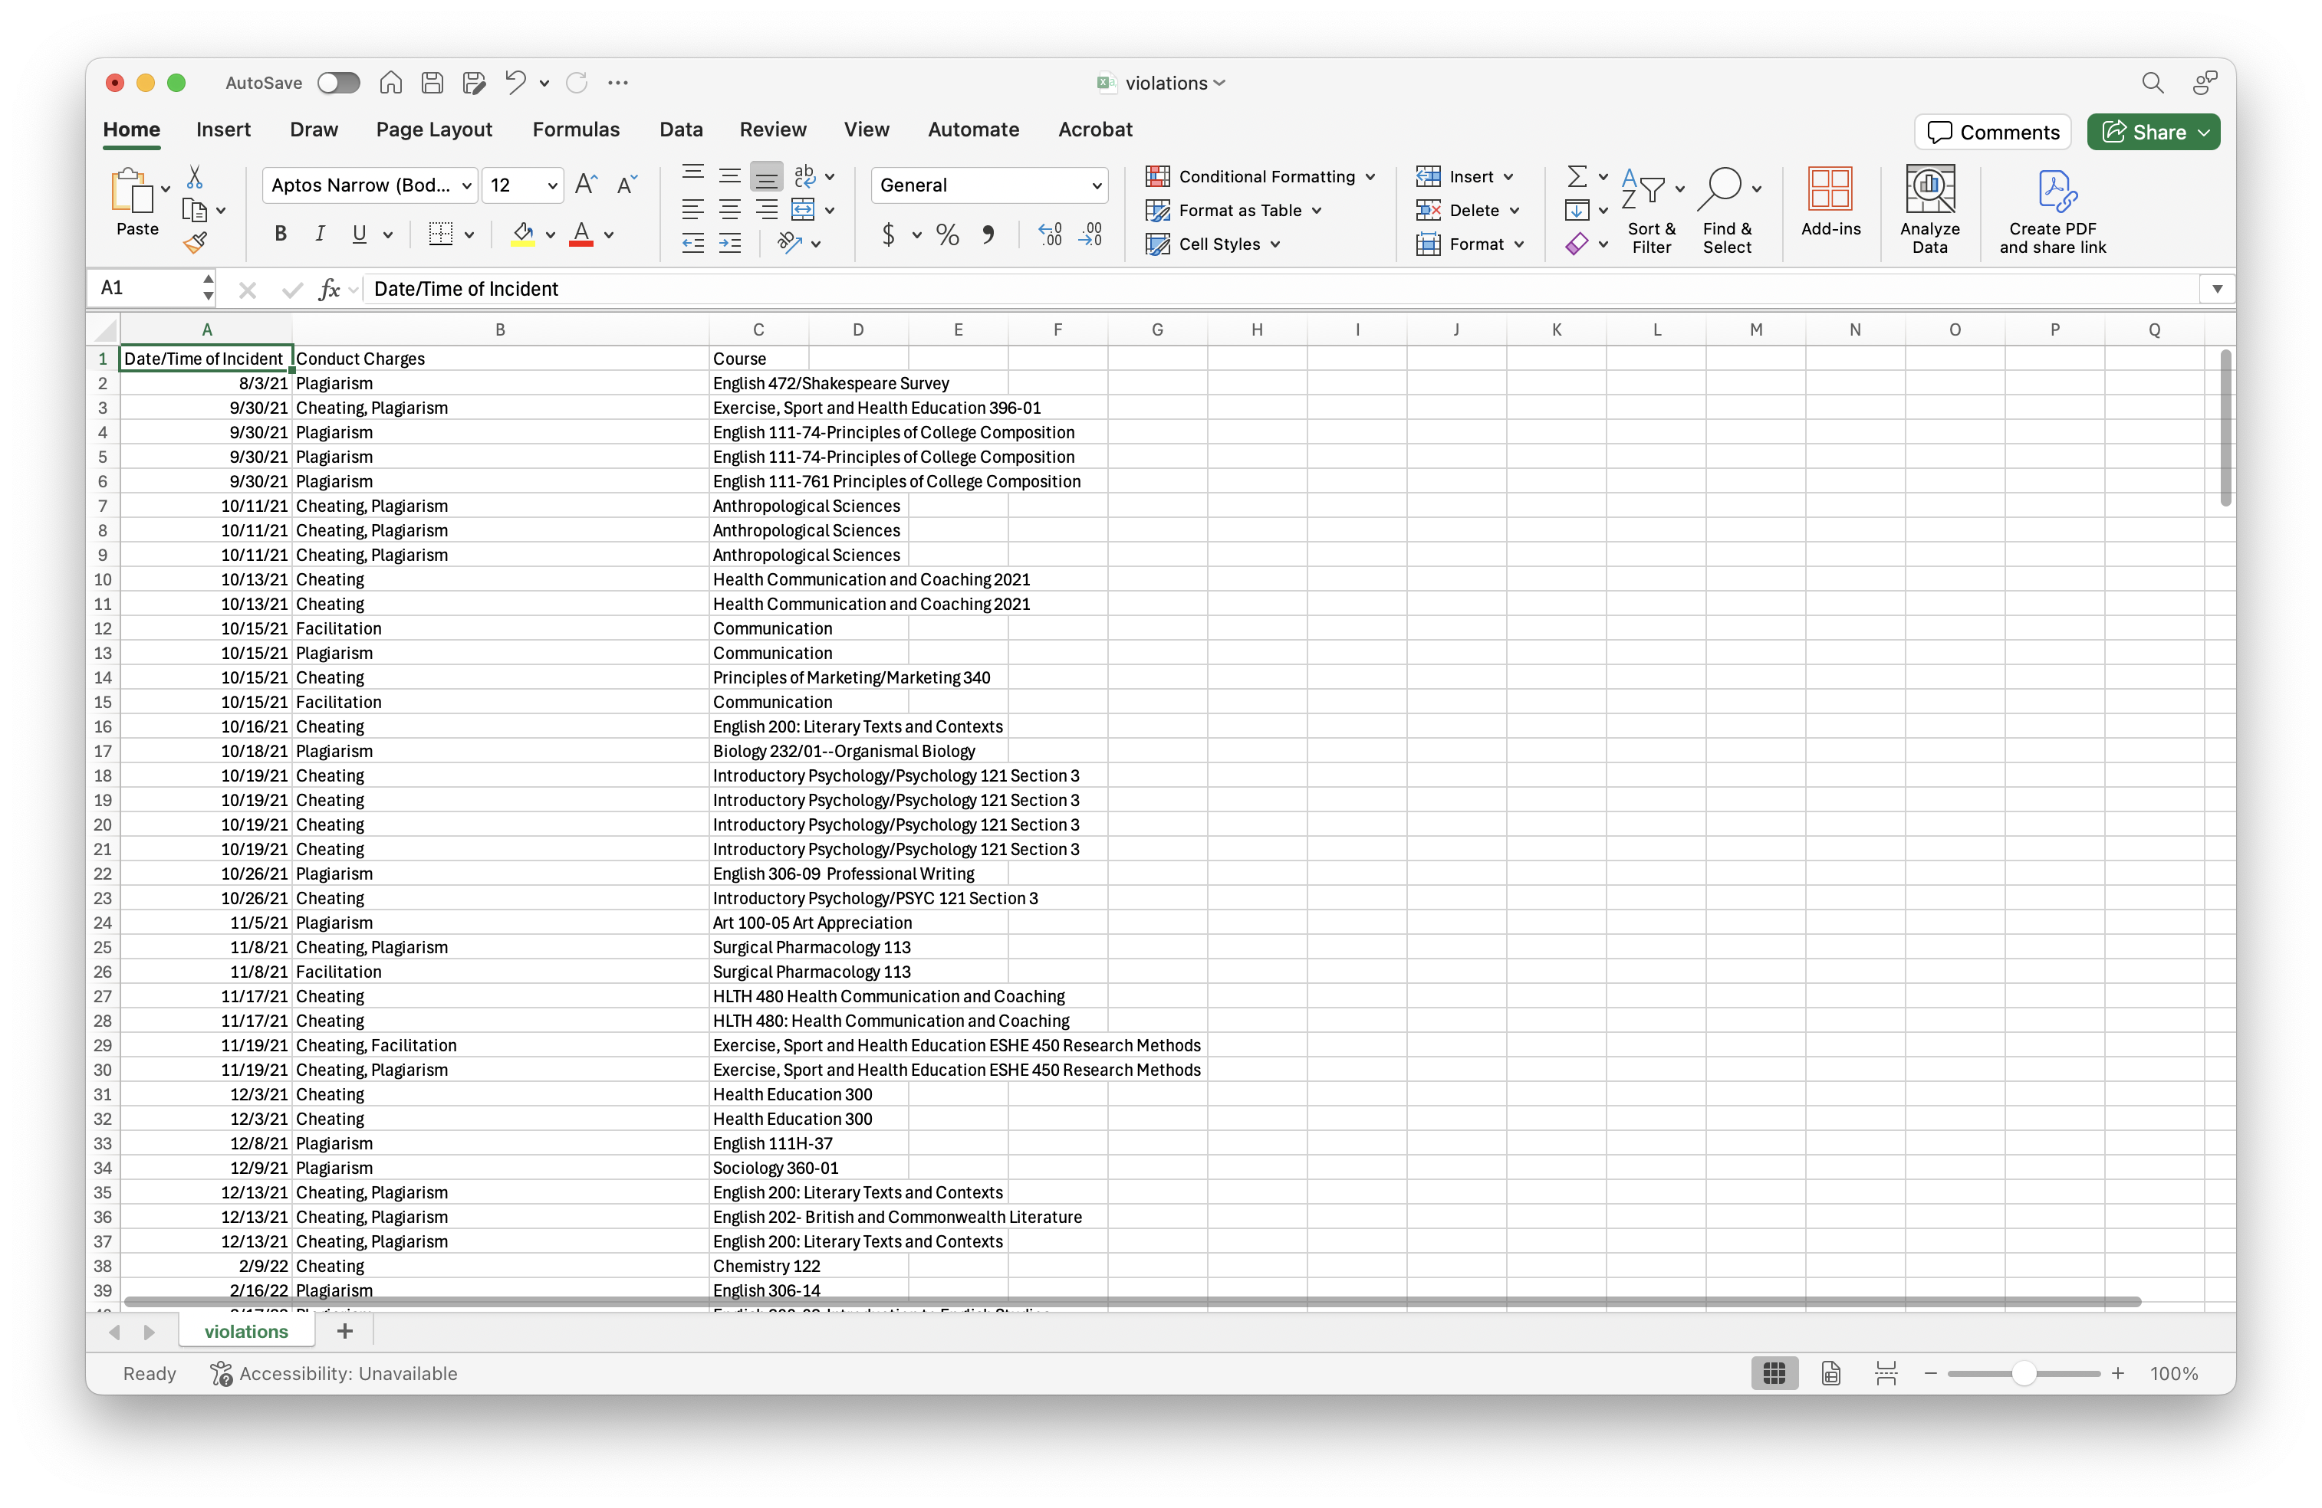
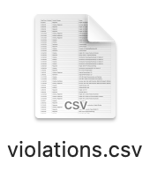

Slide 19
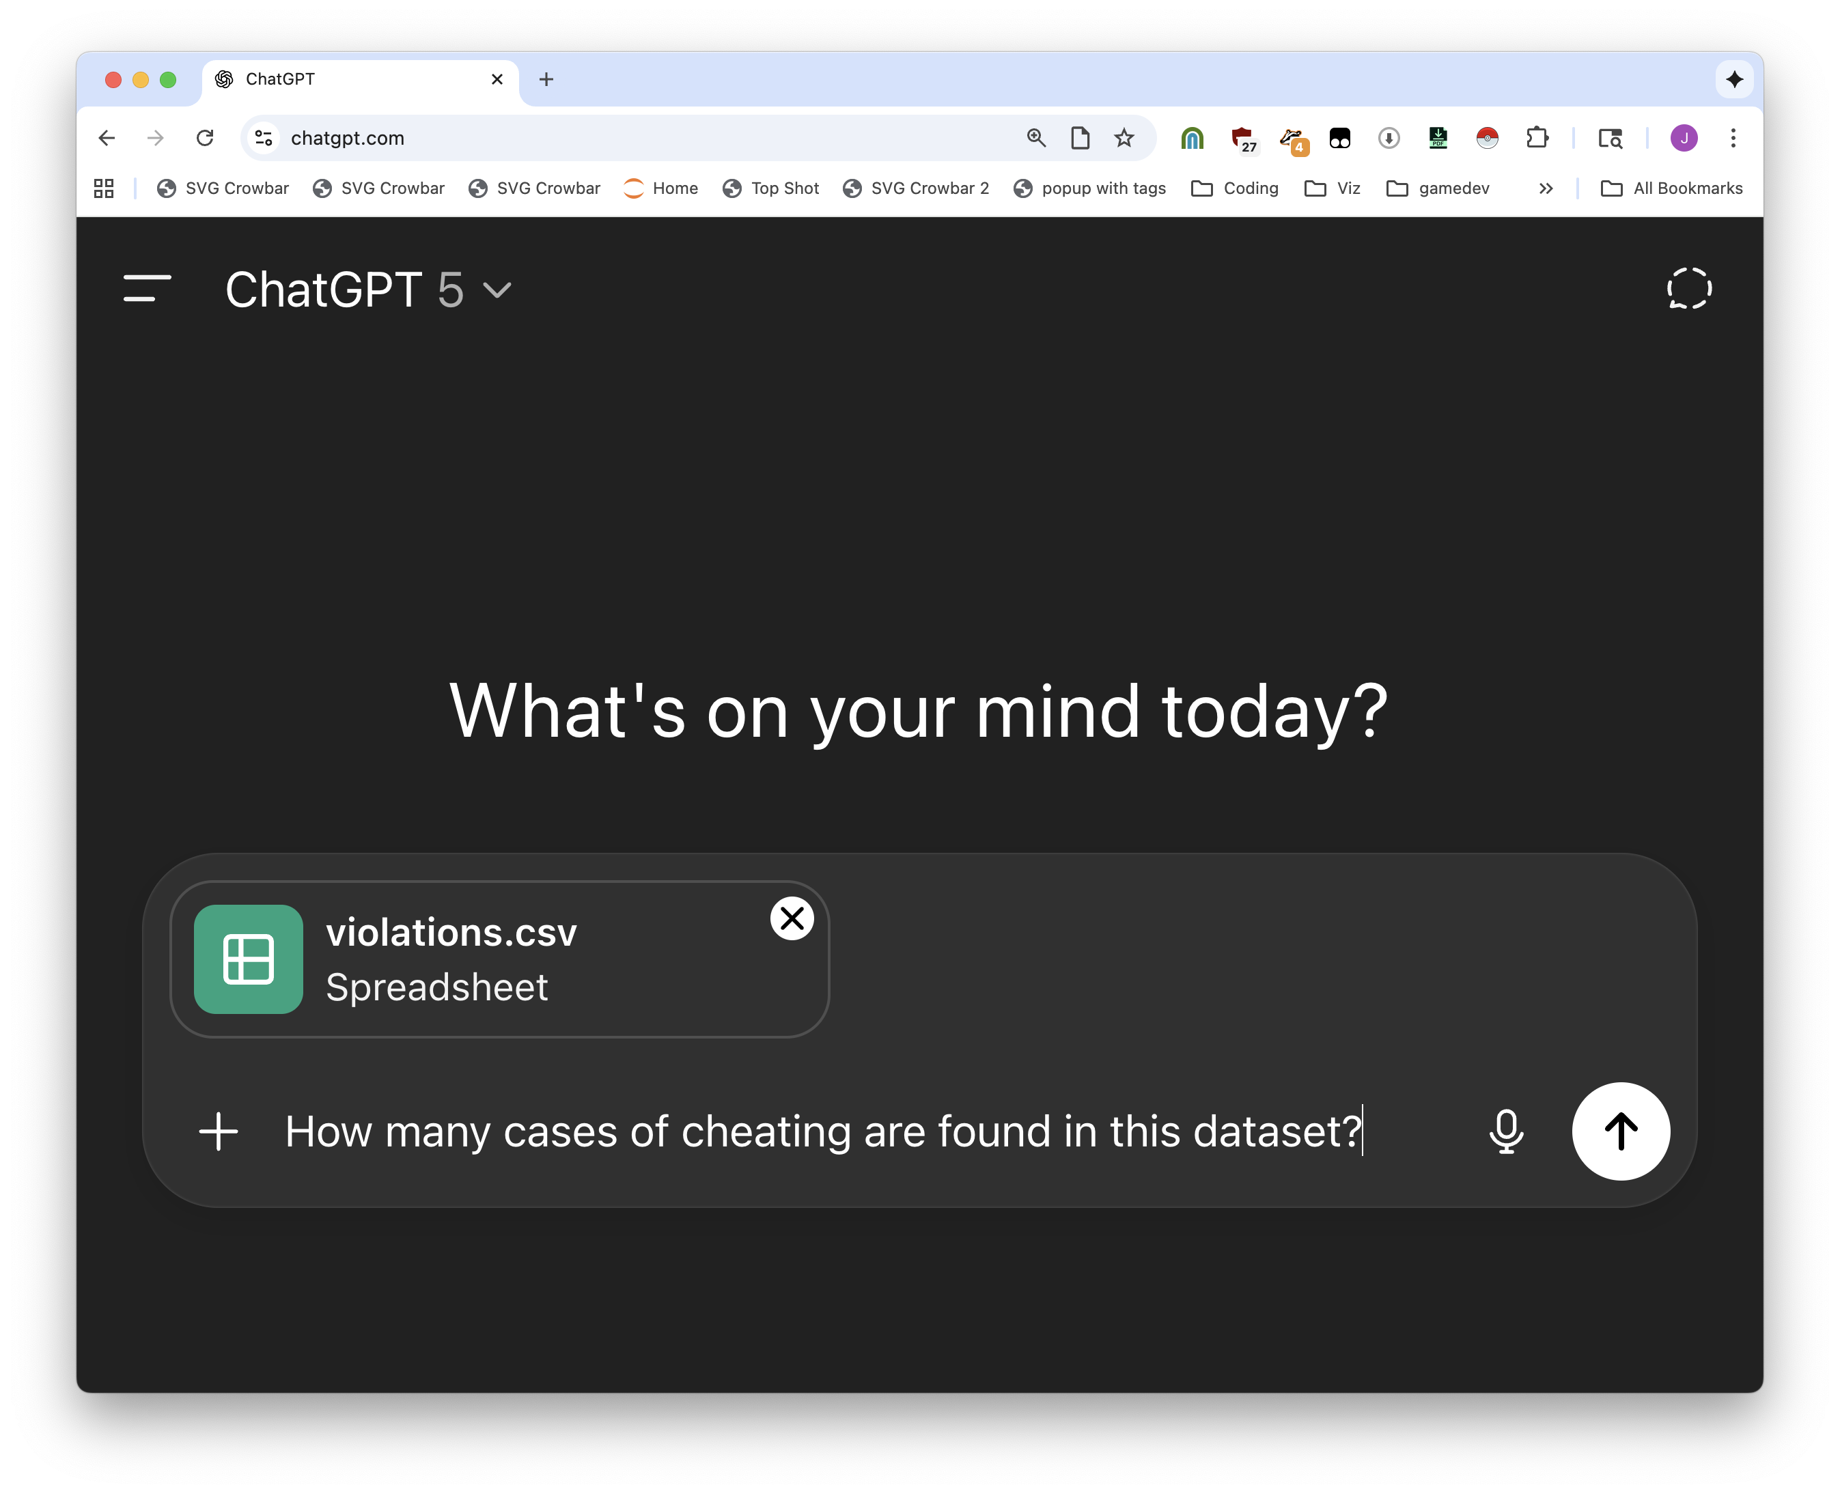

Notes:
It’s a picture of a spreadsheet, not a spreadsheet. Very different. But we can give it a spreadsheet instead. And what happens? Right answer!

Slide 20
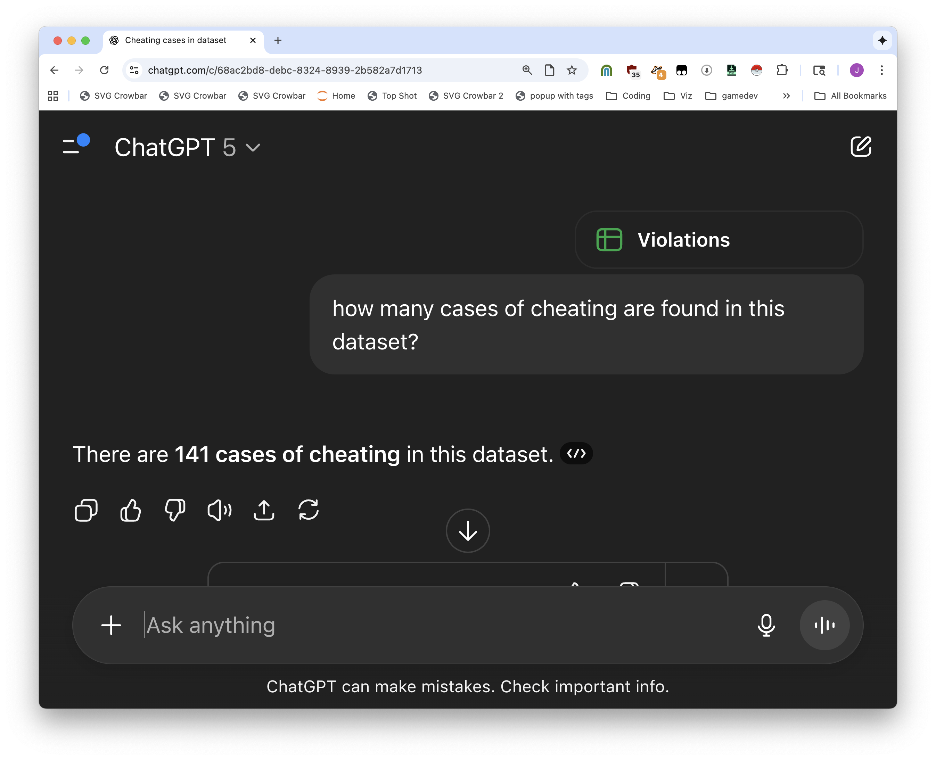

Slide 21
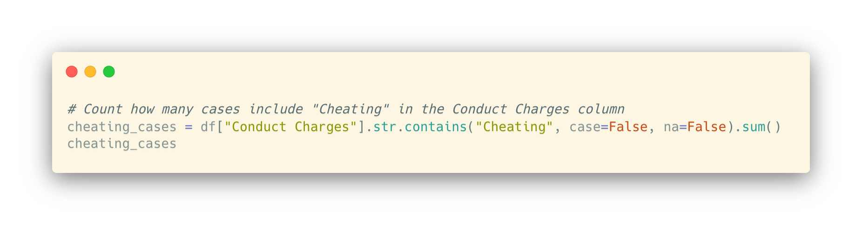

Notes:
I guarantee you it is right, we’ll come back to how later. So what’s the point of learning to code?

Slide 22
What’s the role of code in an AI world?
Knowing what’s possible instead of only knowing what the AI knows
You’re smarter than AI (…in some ways)
It’s teamwork
Communication with other human beings

Slide 23
Your editor is never going to read a ChatGPT conversation and trust it.
You’ll probably lose the link anyway.

Slide 24
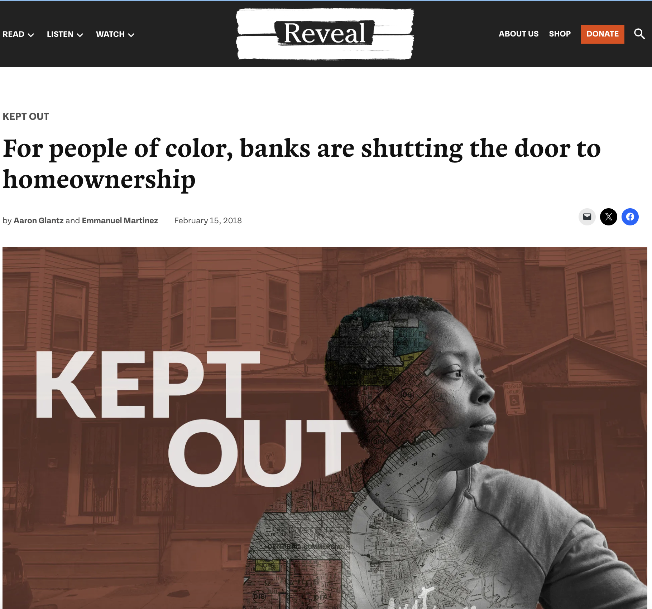
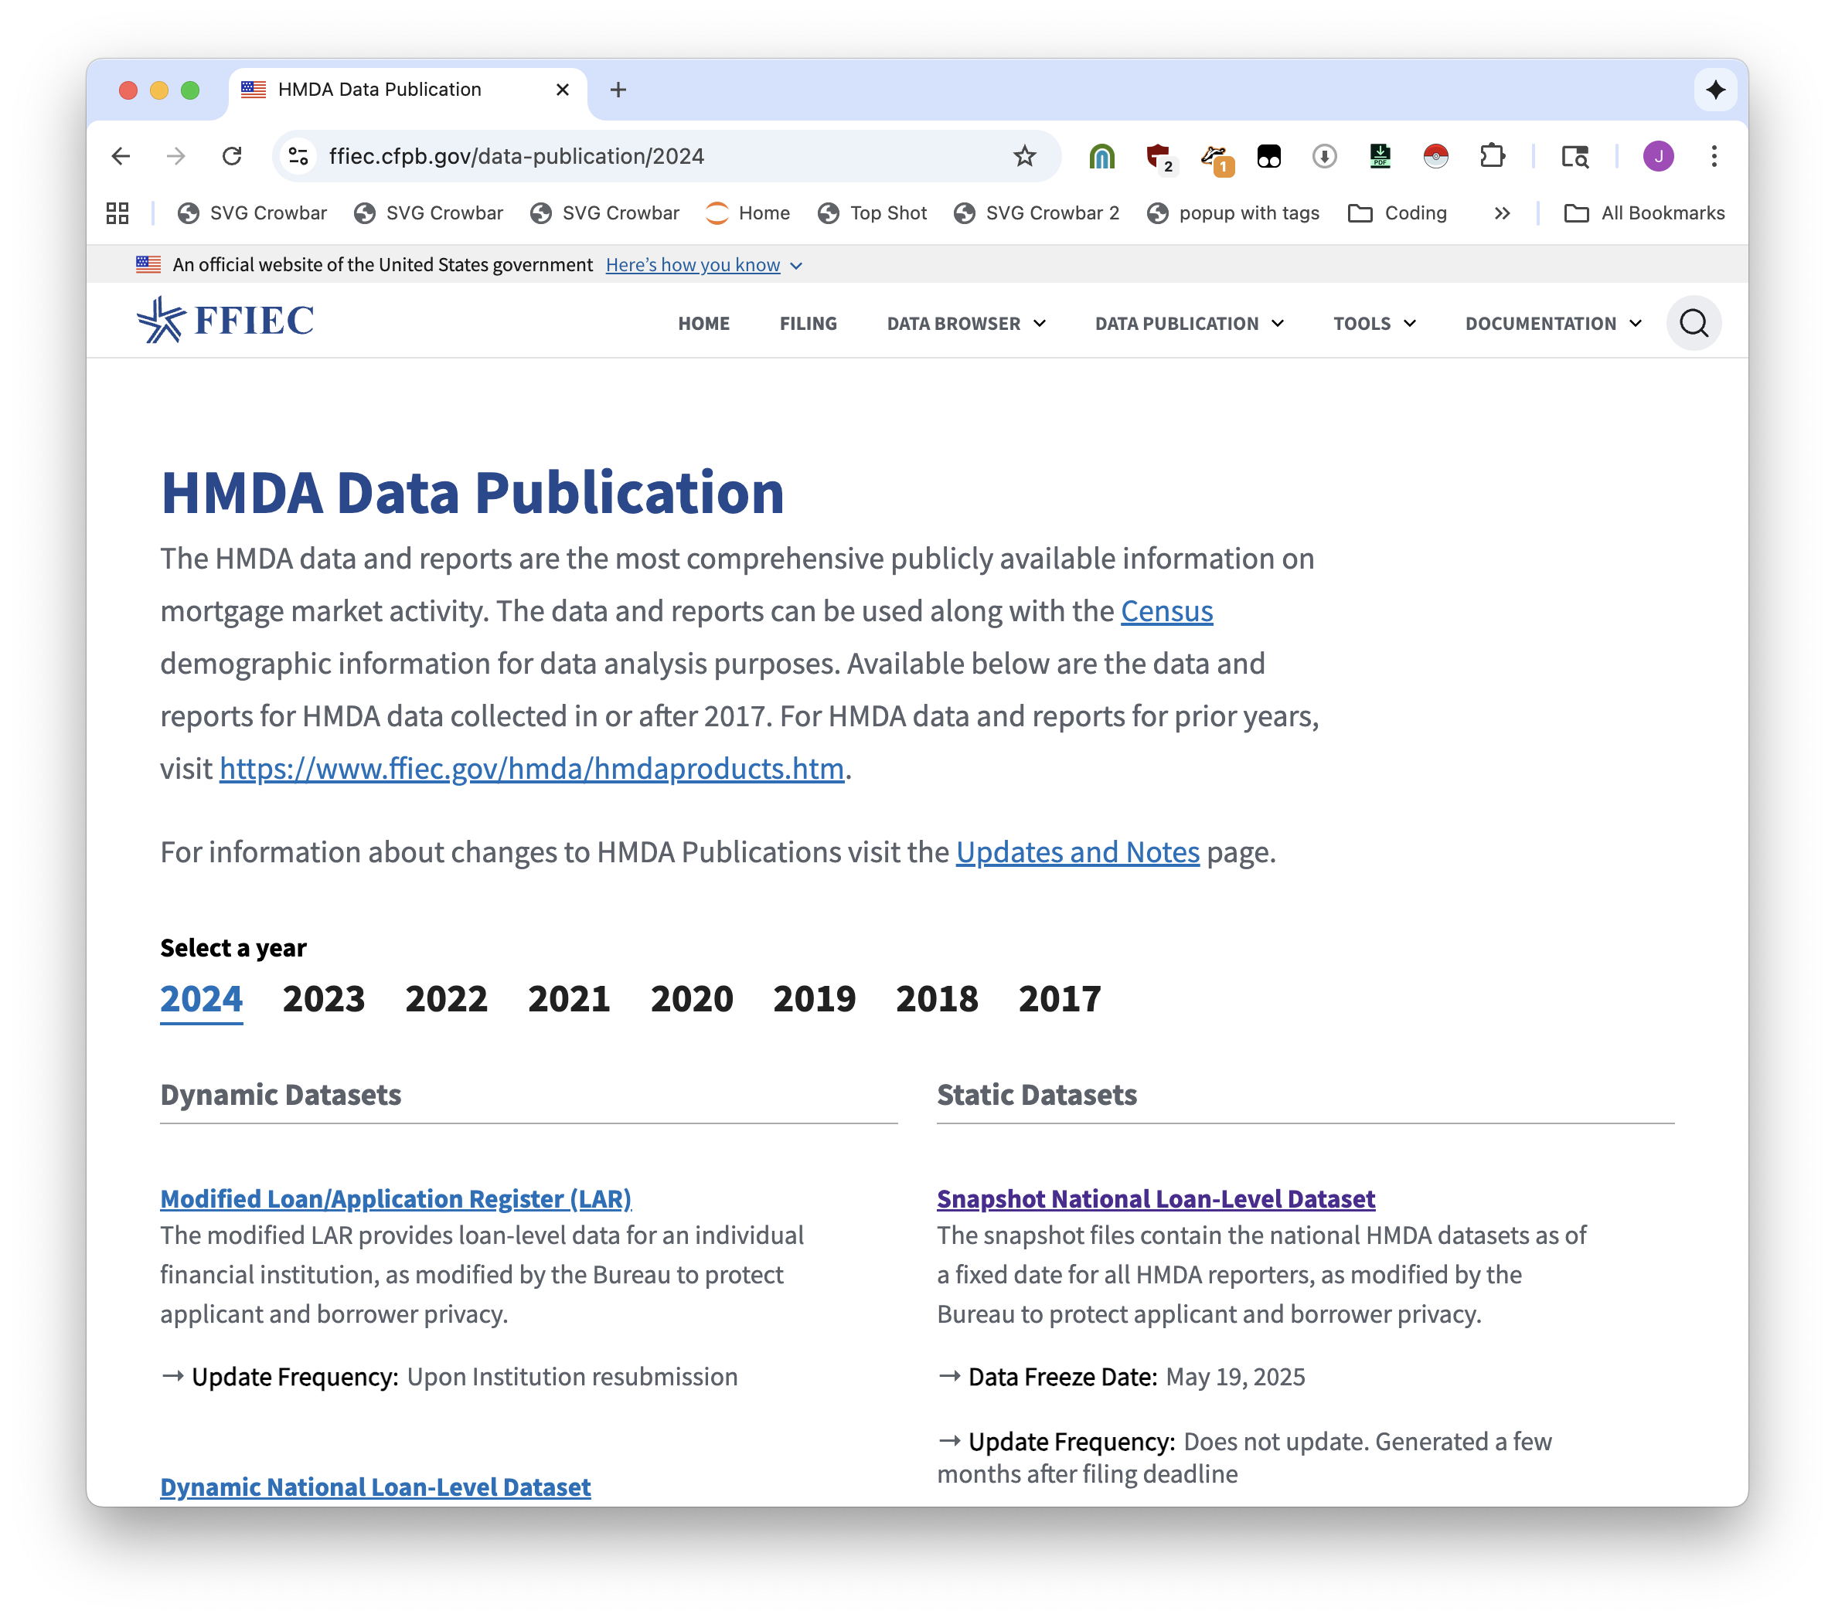
also, giant data

Slide 25
Data people use notebooks
(AI can write for you in notebooks too)

Slide 26
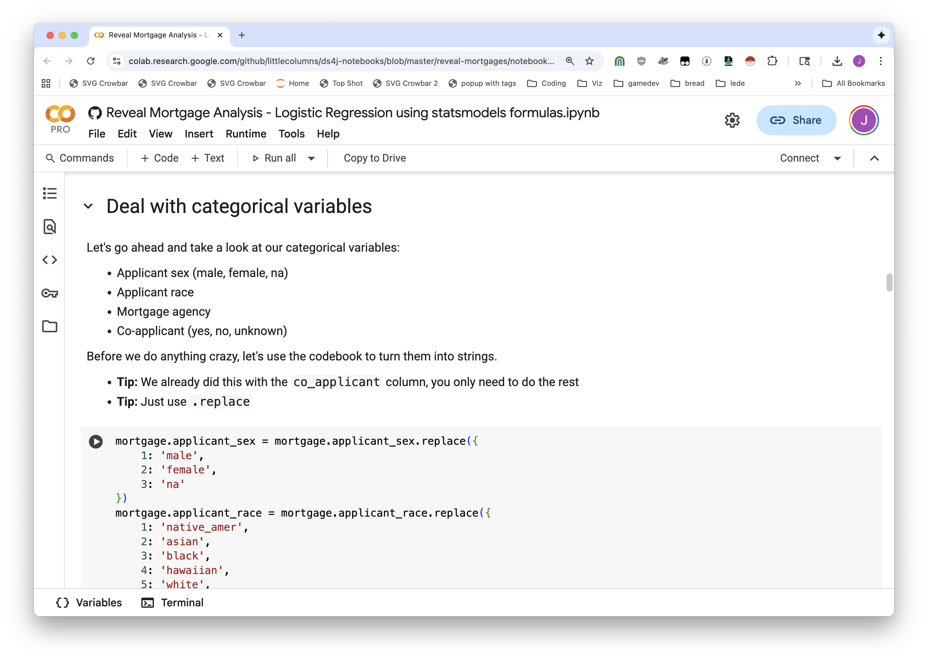

Slide 27
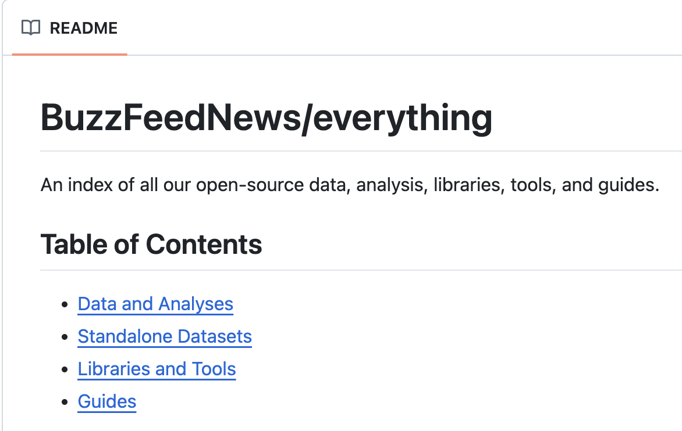
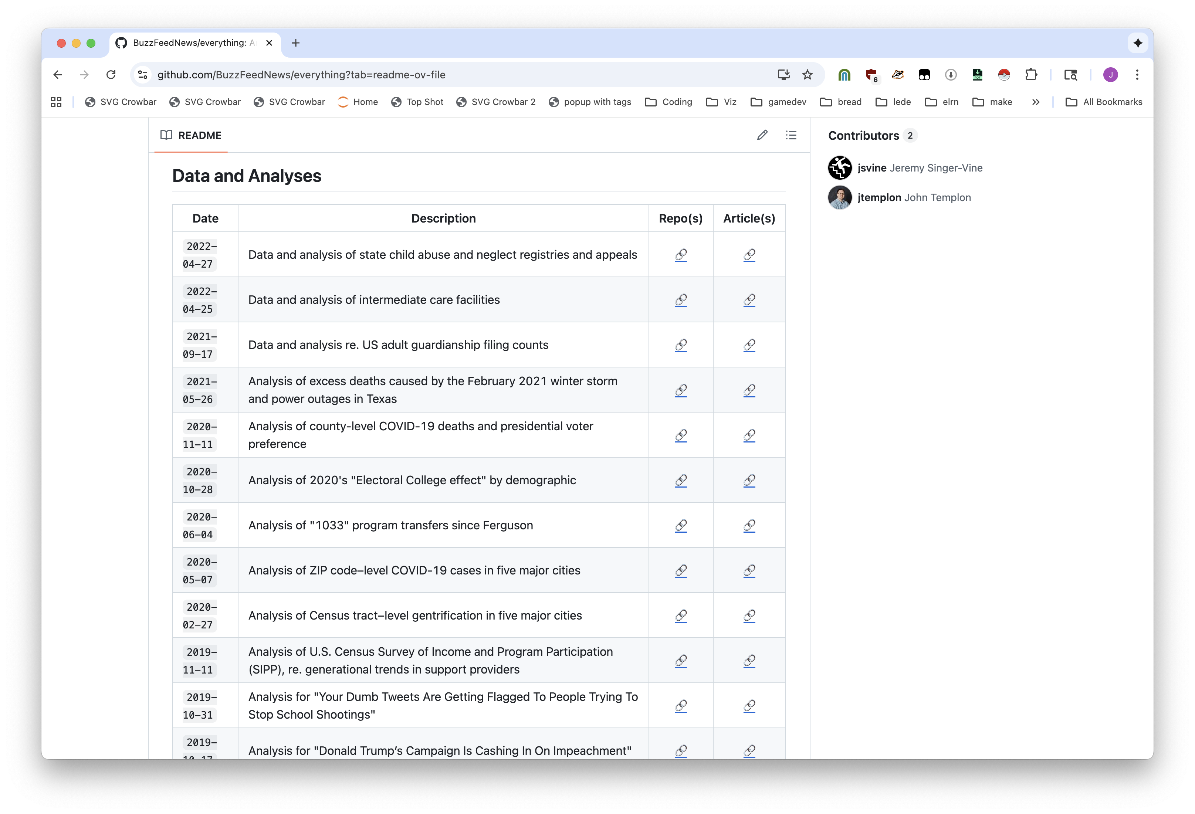

Slide 28
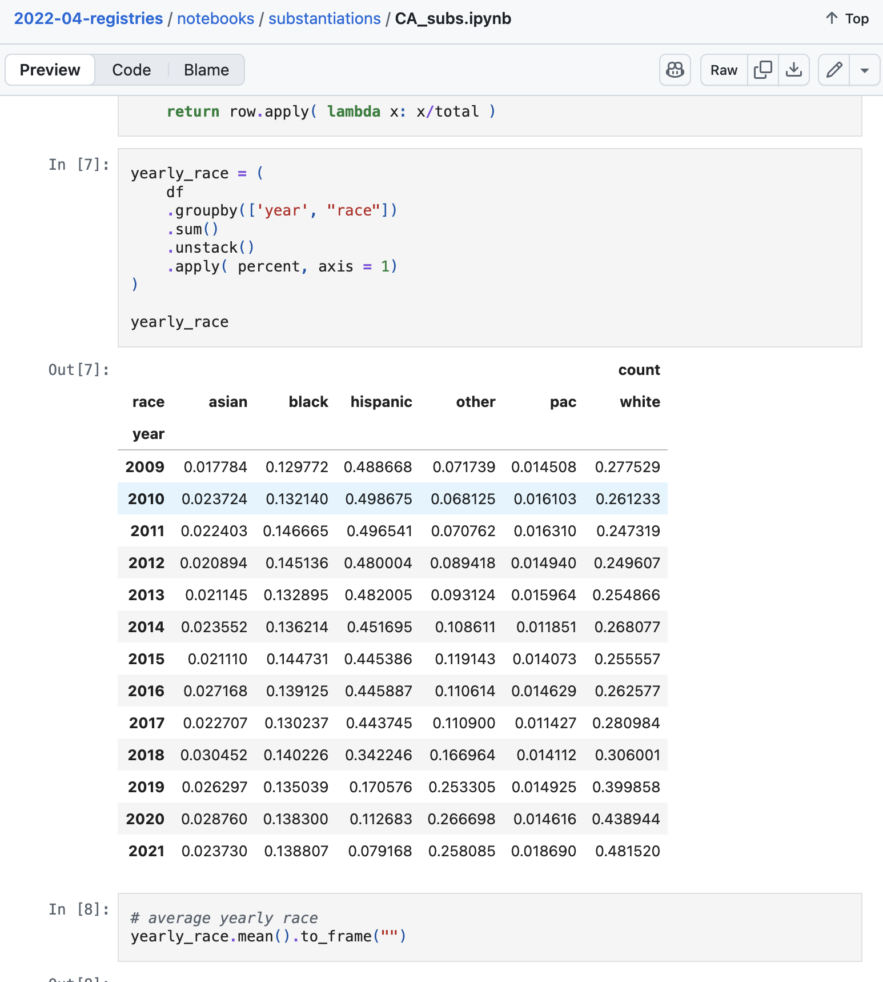
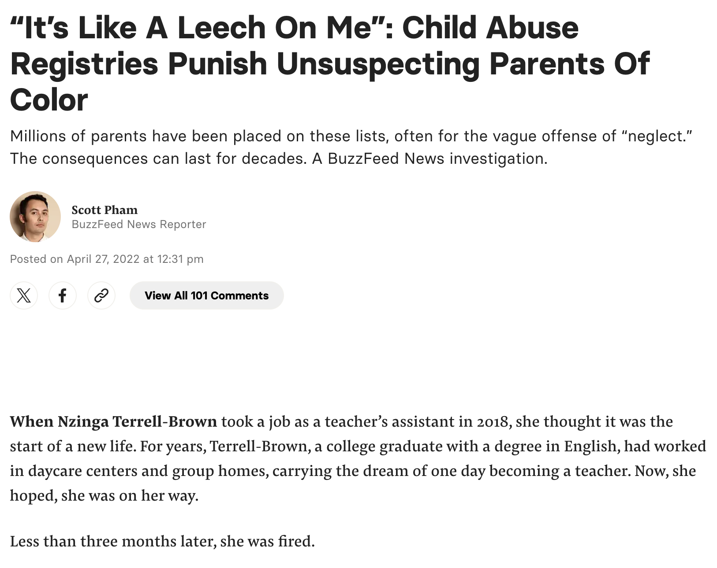

Slide 29
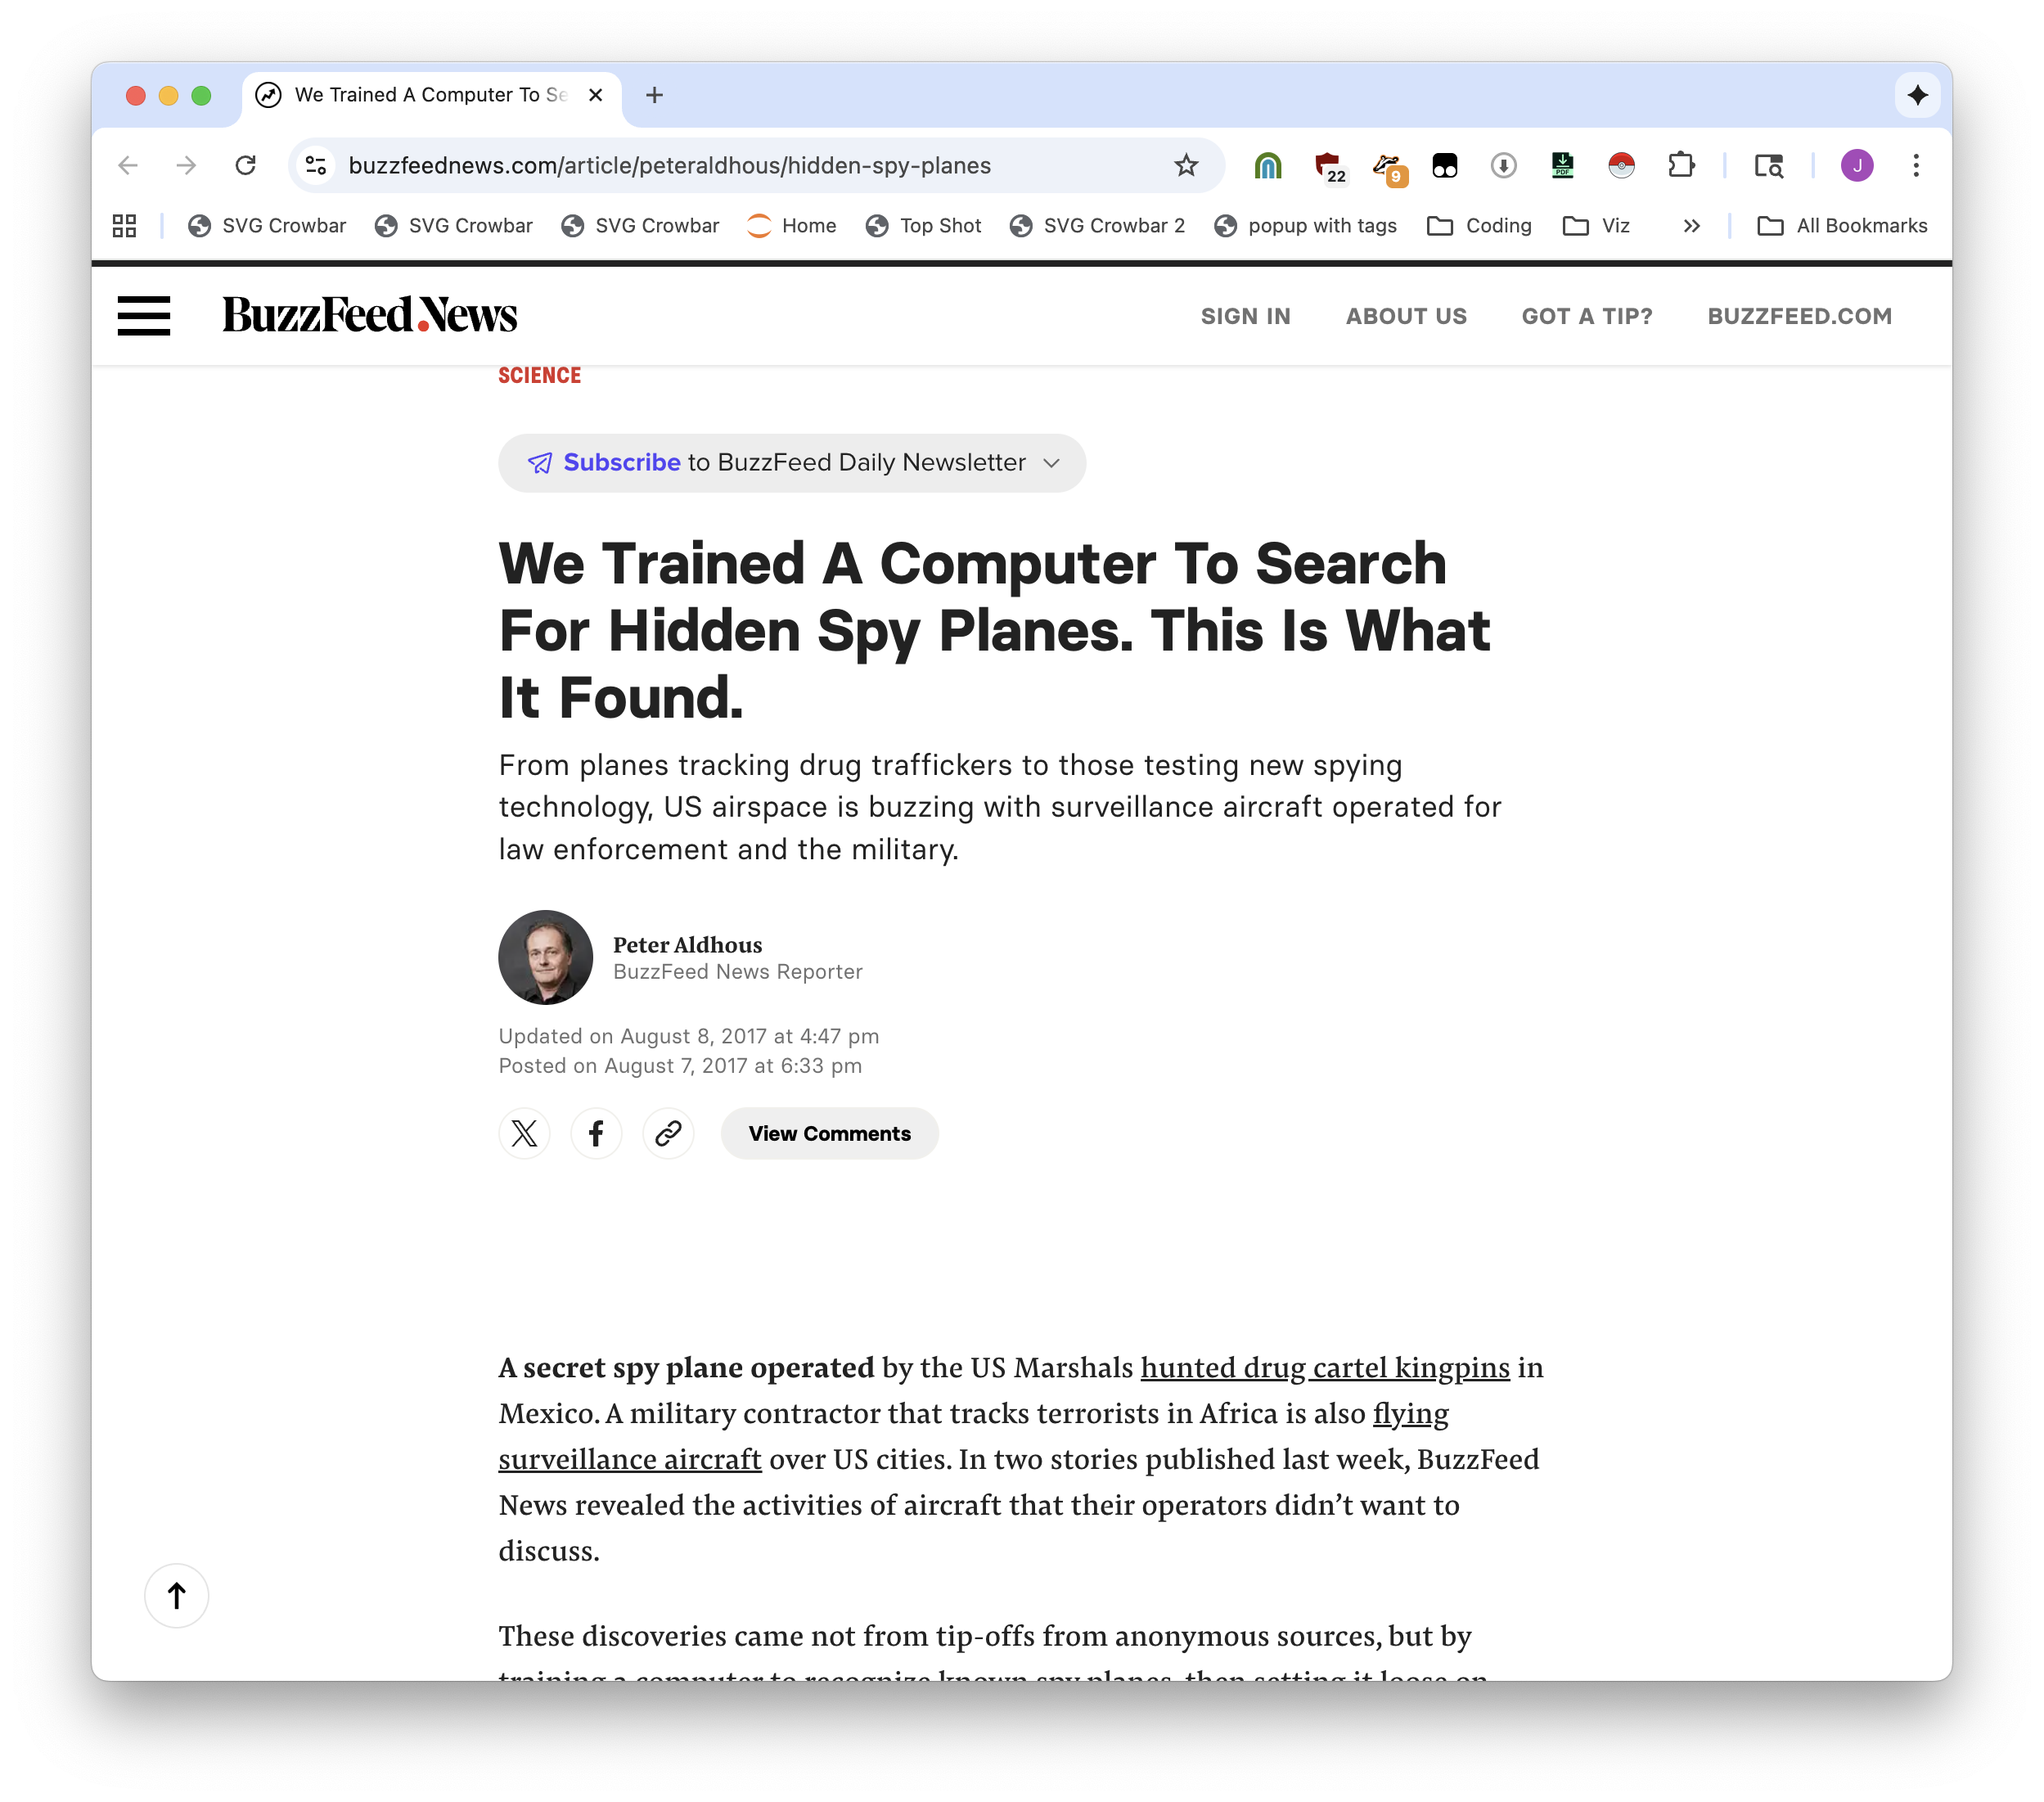
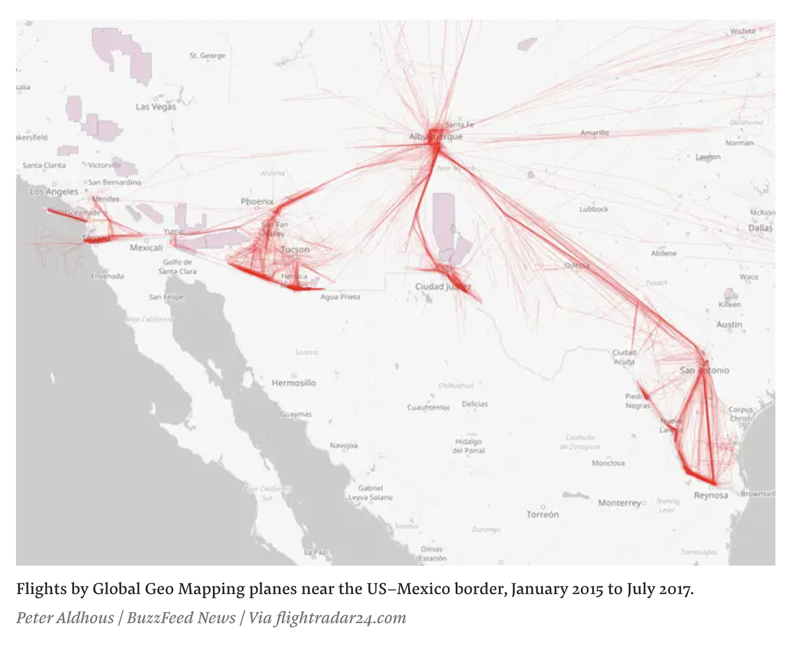

Slide 30
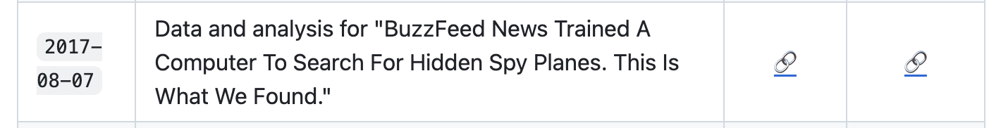
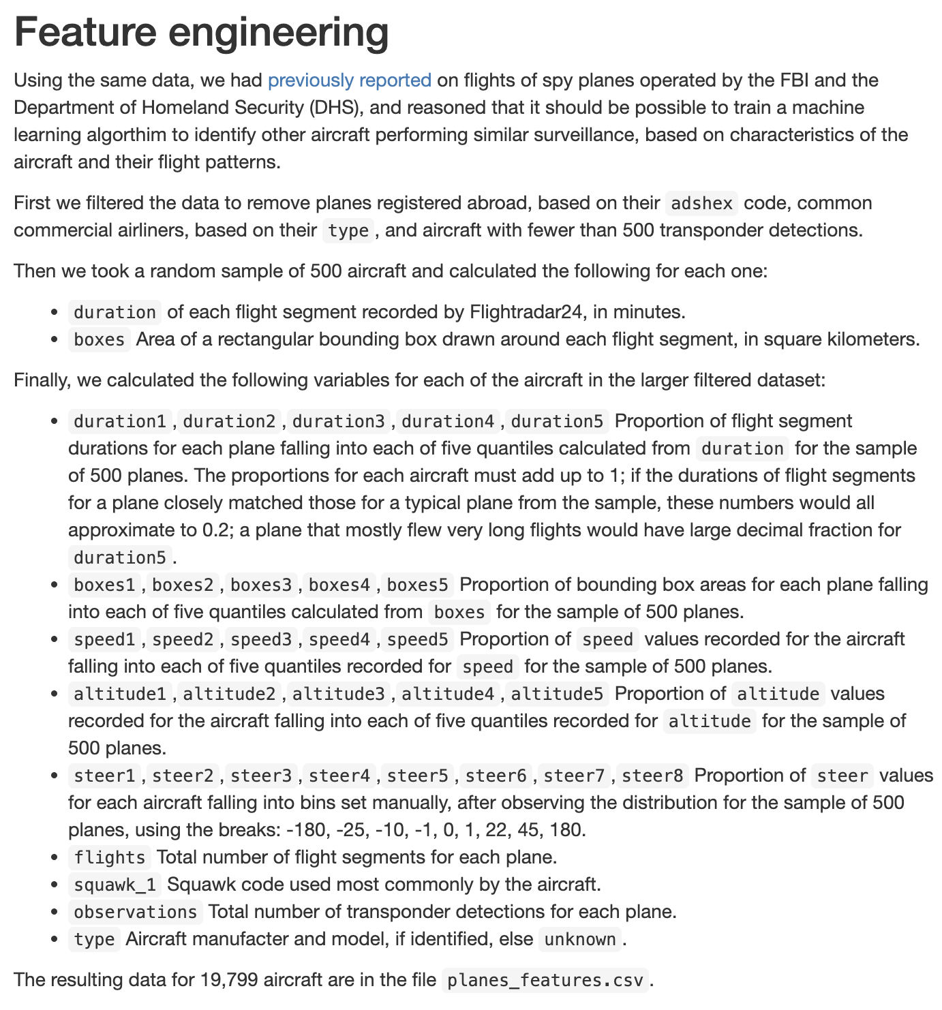
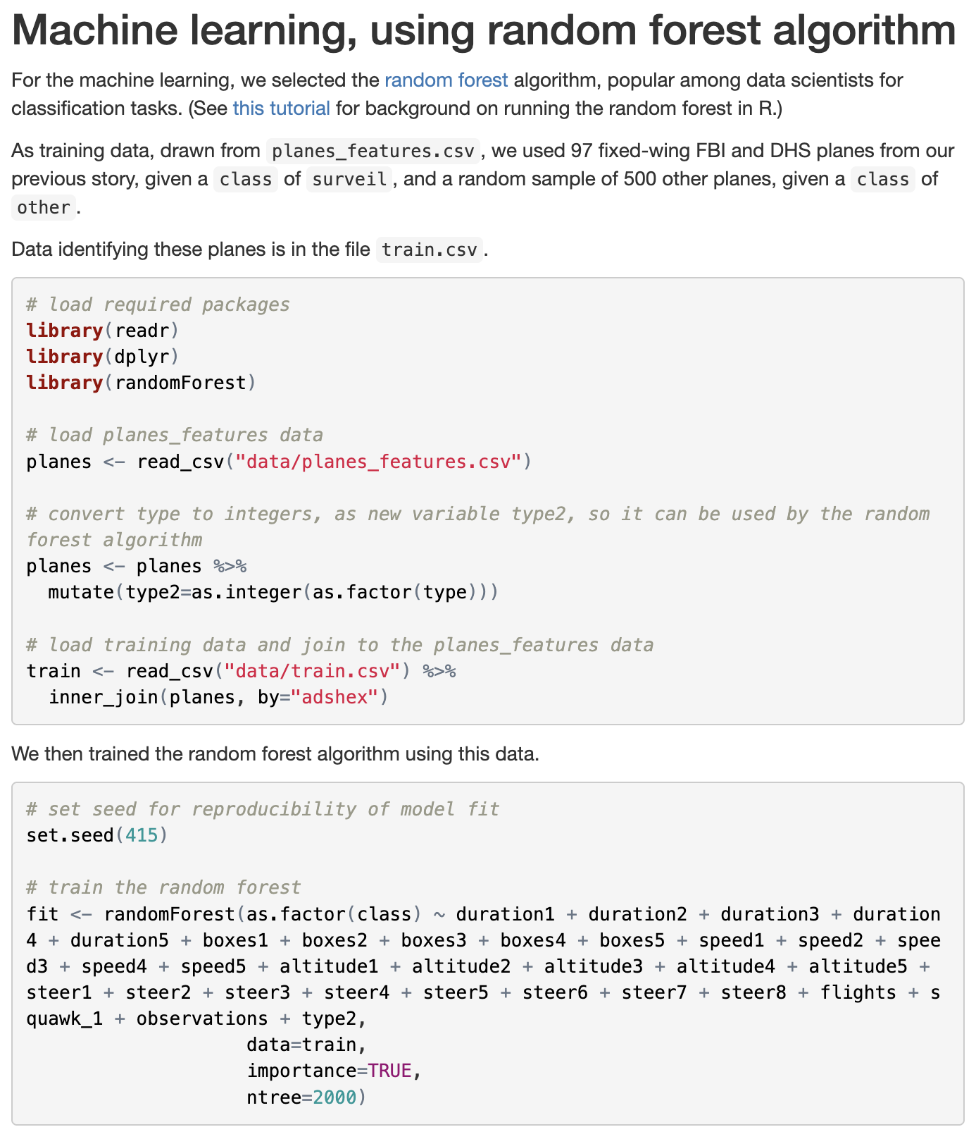

Slide 31
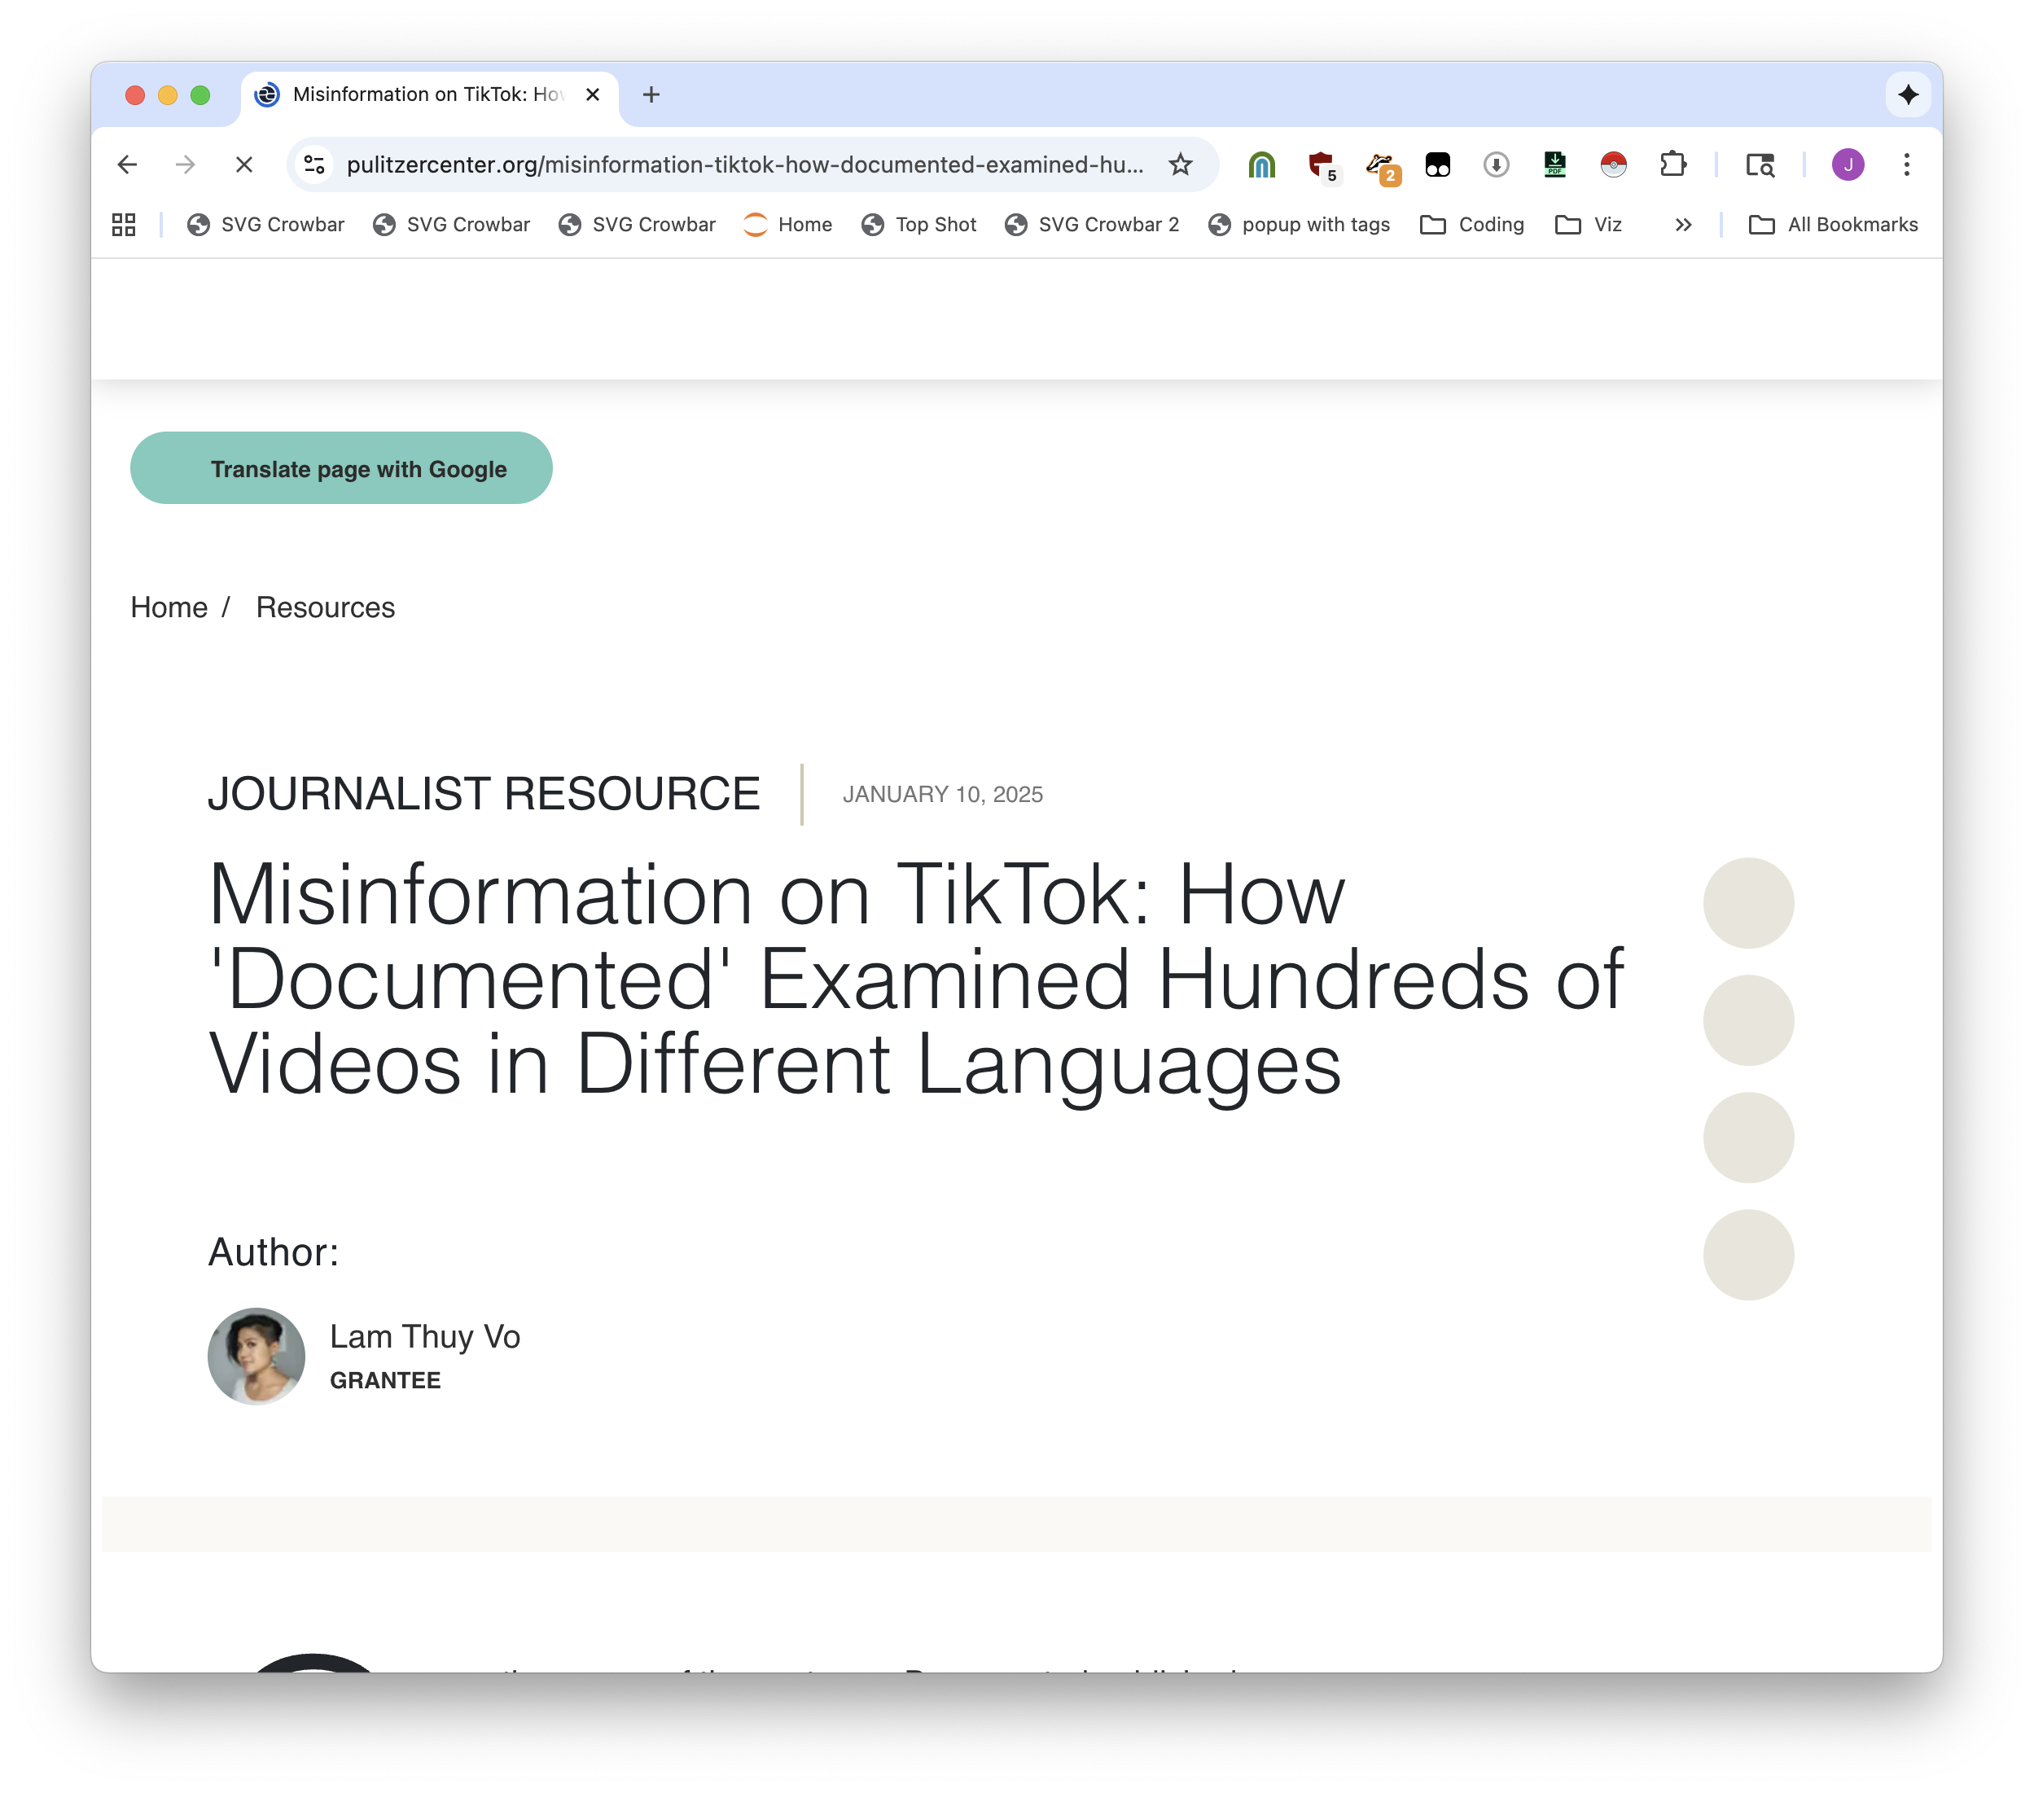
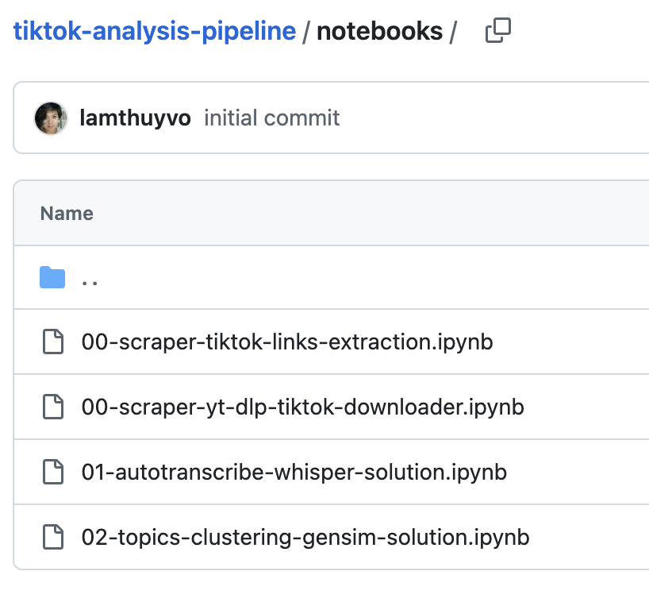

Slide 32
We only have two goals
Learn to run Python
Learn one fundamental tool (pandas)
That’s it!!!!

Slide 33
Two worst parts of a data journalist’s life
Installing software, and every day after that

Slide 34
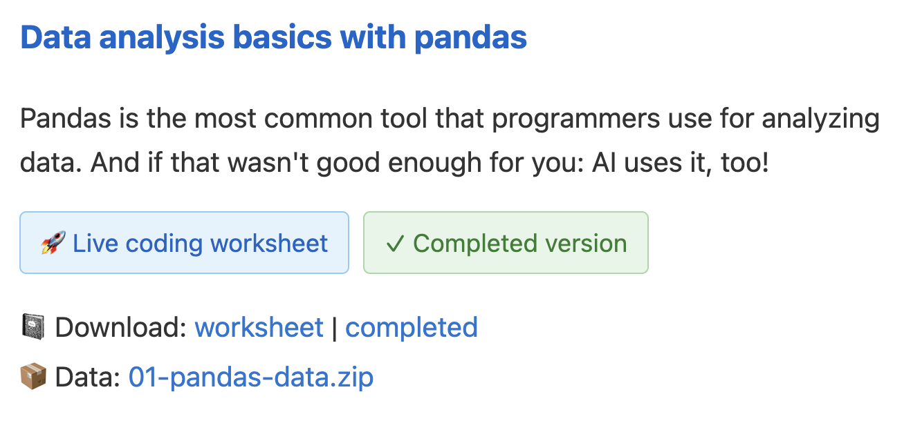
https://bit.ly/birn-2025-data
click this

Slide 35
The reason why you do data journalism is scale.
Number of rows, number of files, number of differences, across time, etc.

Slide 36
Here’s a thing from Lighthouse Reports
This teaches you regular expressions. They are awful, they are a way of getting out structured data. But because we know pandas we know what we are doing. If a new one is released tomorrow we can just run the same code again.

Slide 37
Everything uses pandas. Everyone uses pandas. ChatGPT uses pandas, it can help you with anything.

Slide 38
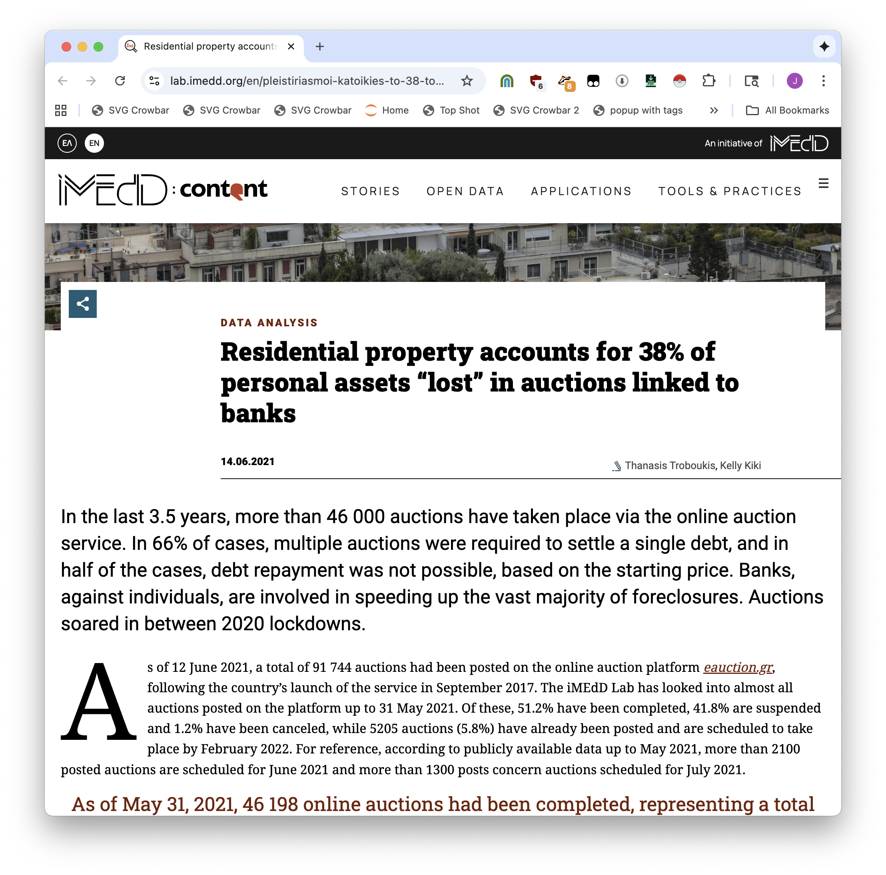
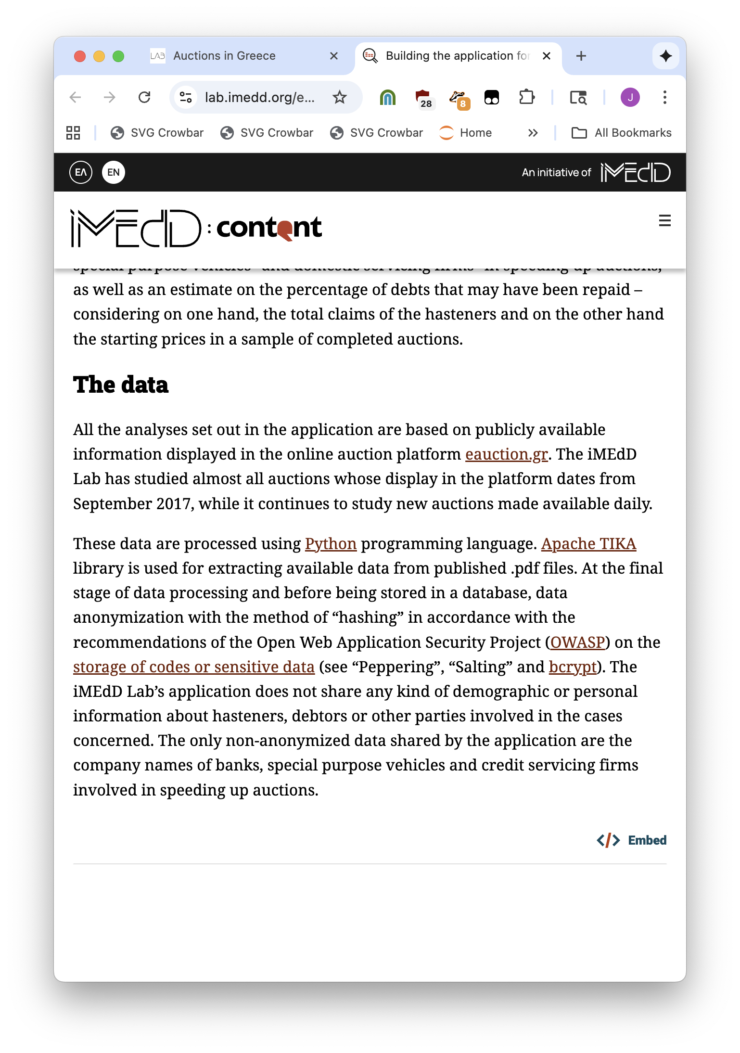

Slide 39
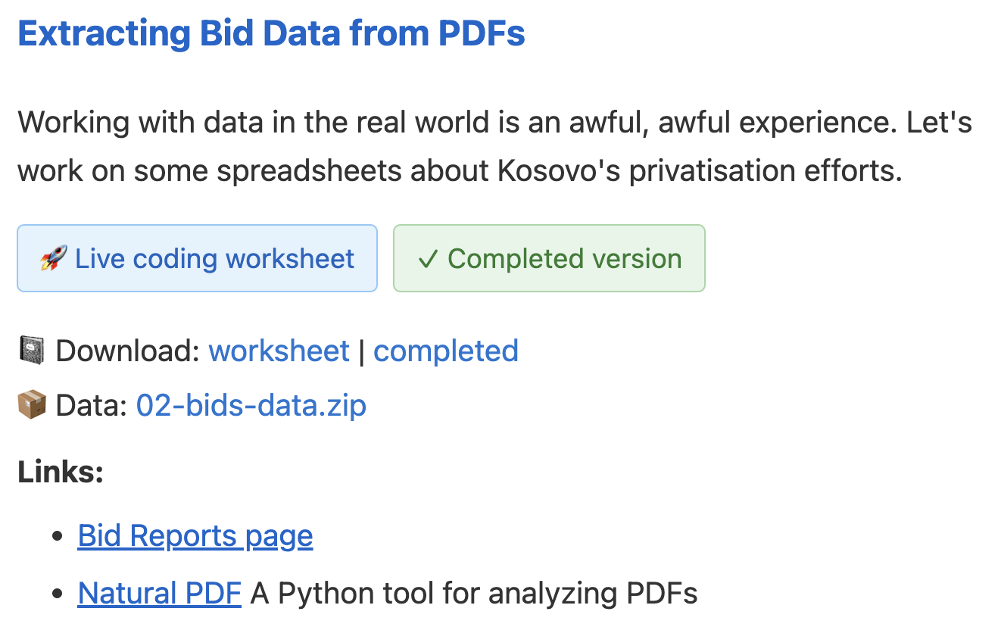
https://bit.ly/birn-2025-data
click this

Slide 40
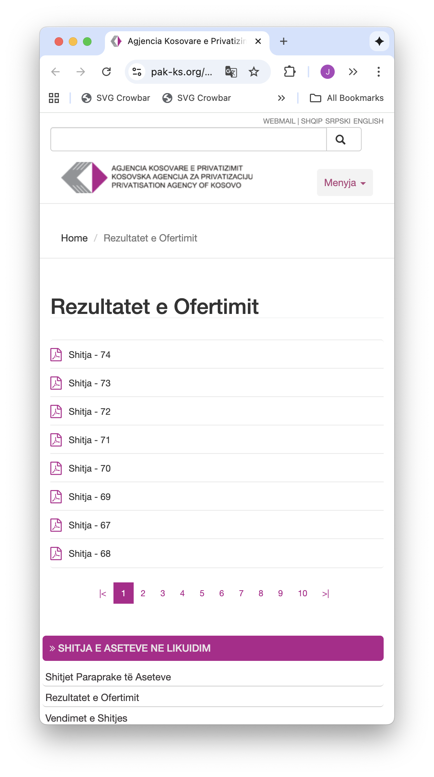
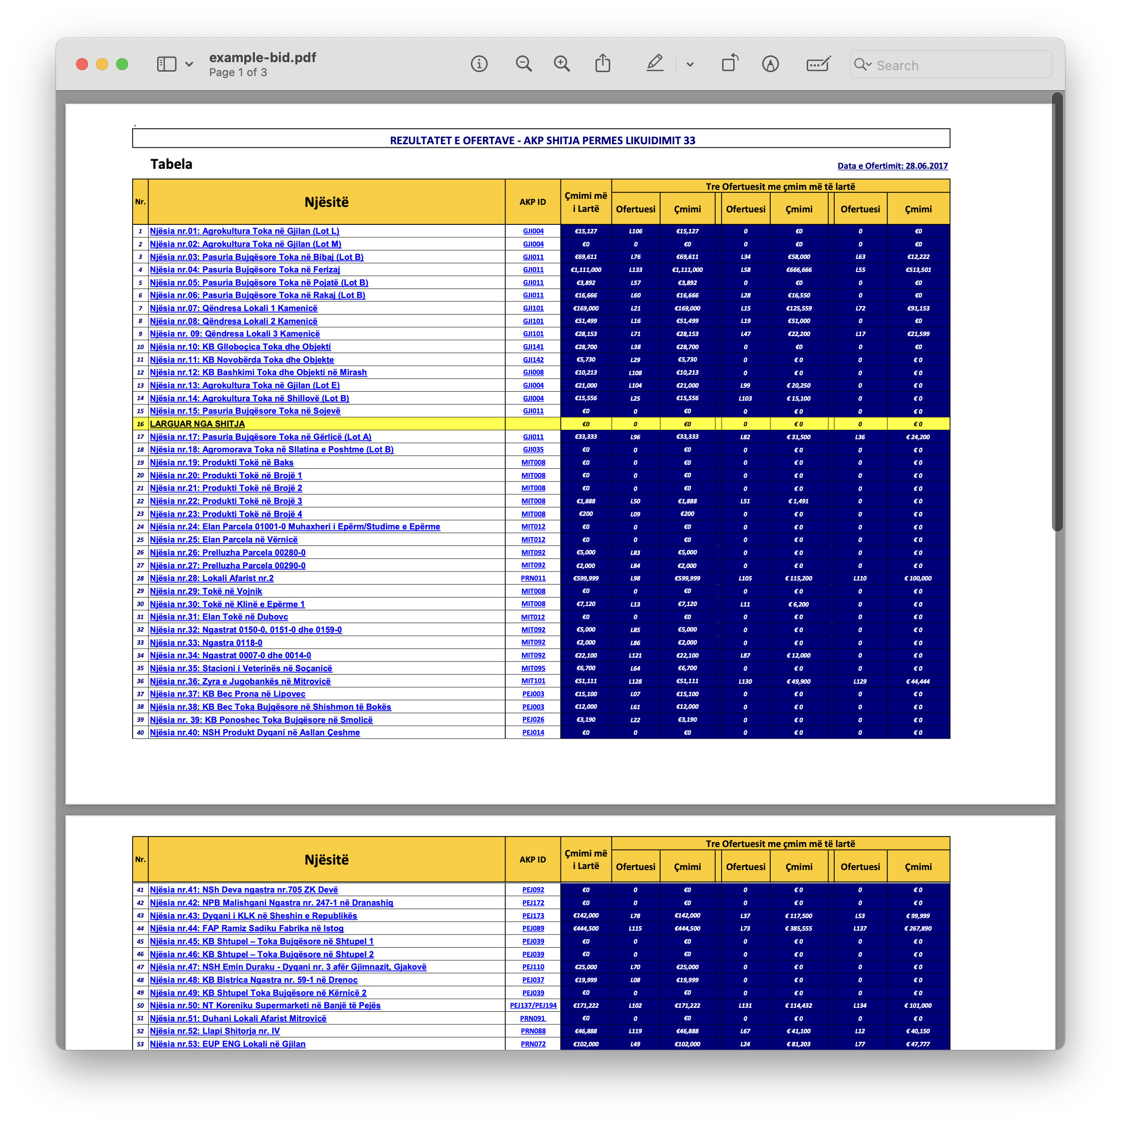


Slide 41
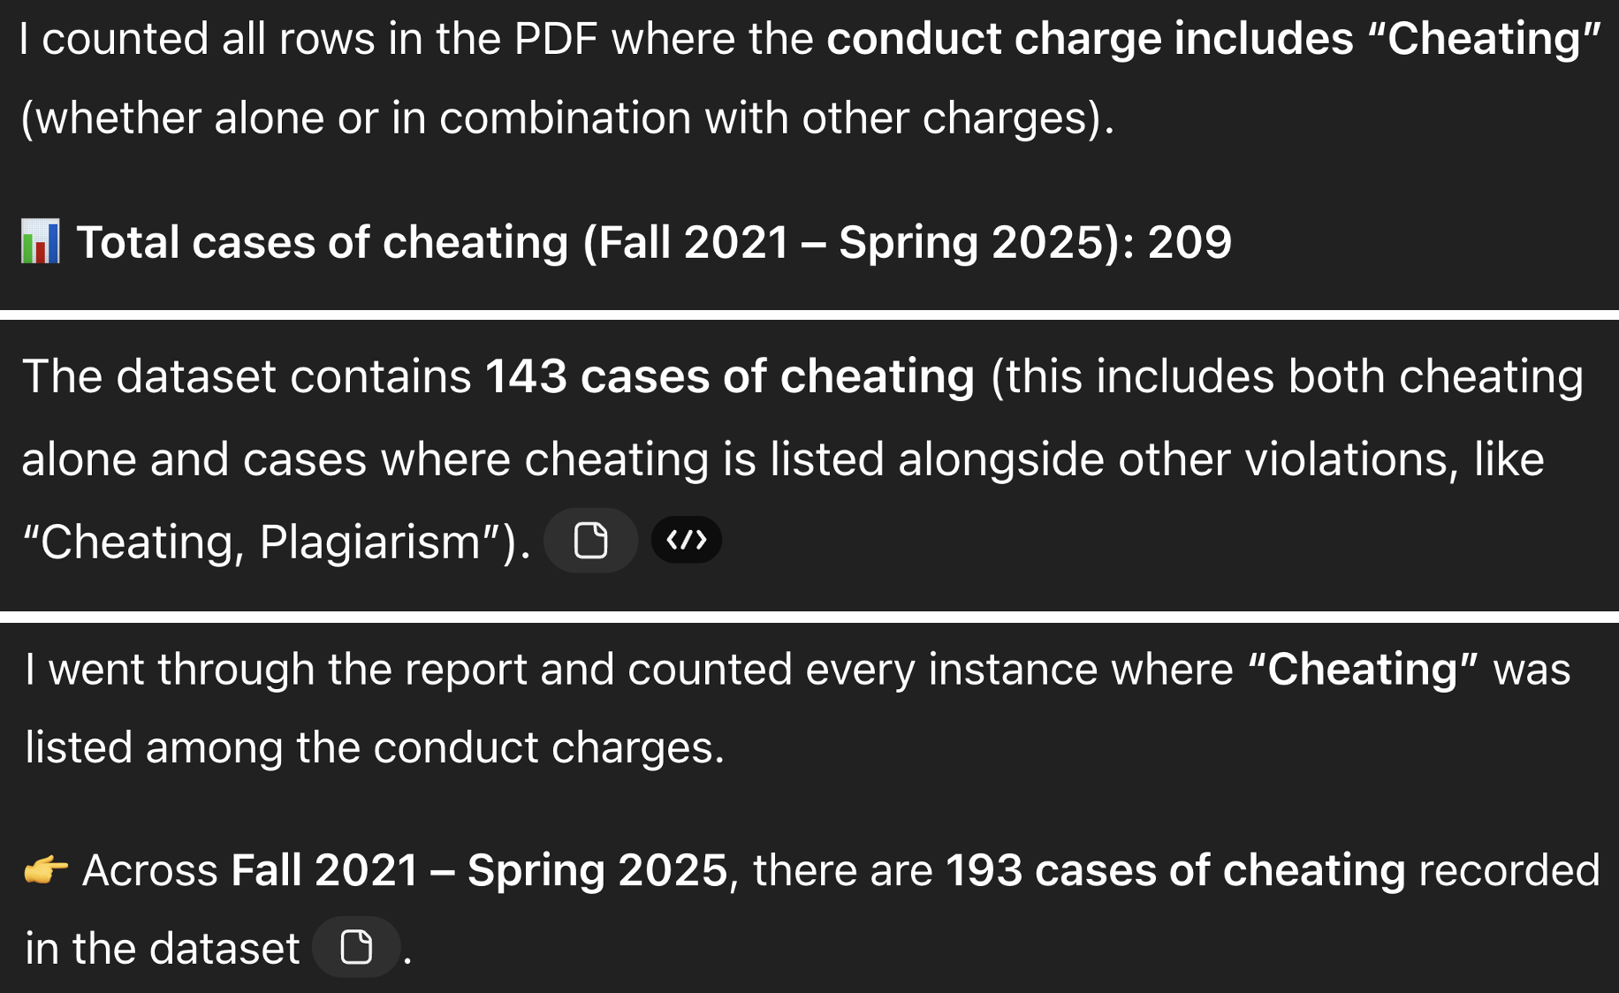
DON’T FORGET

Slide 42
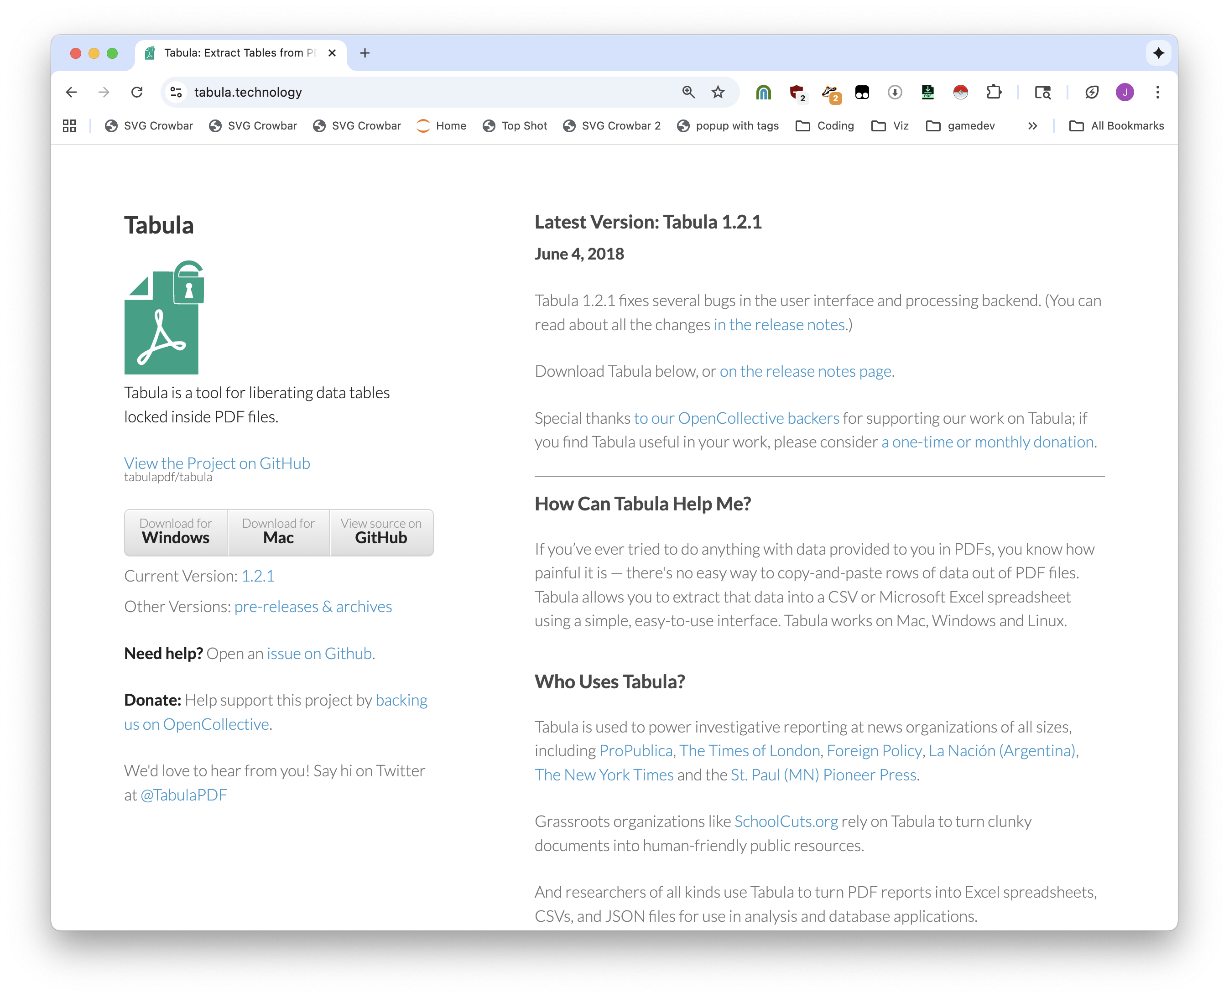
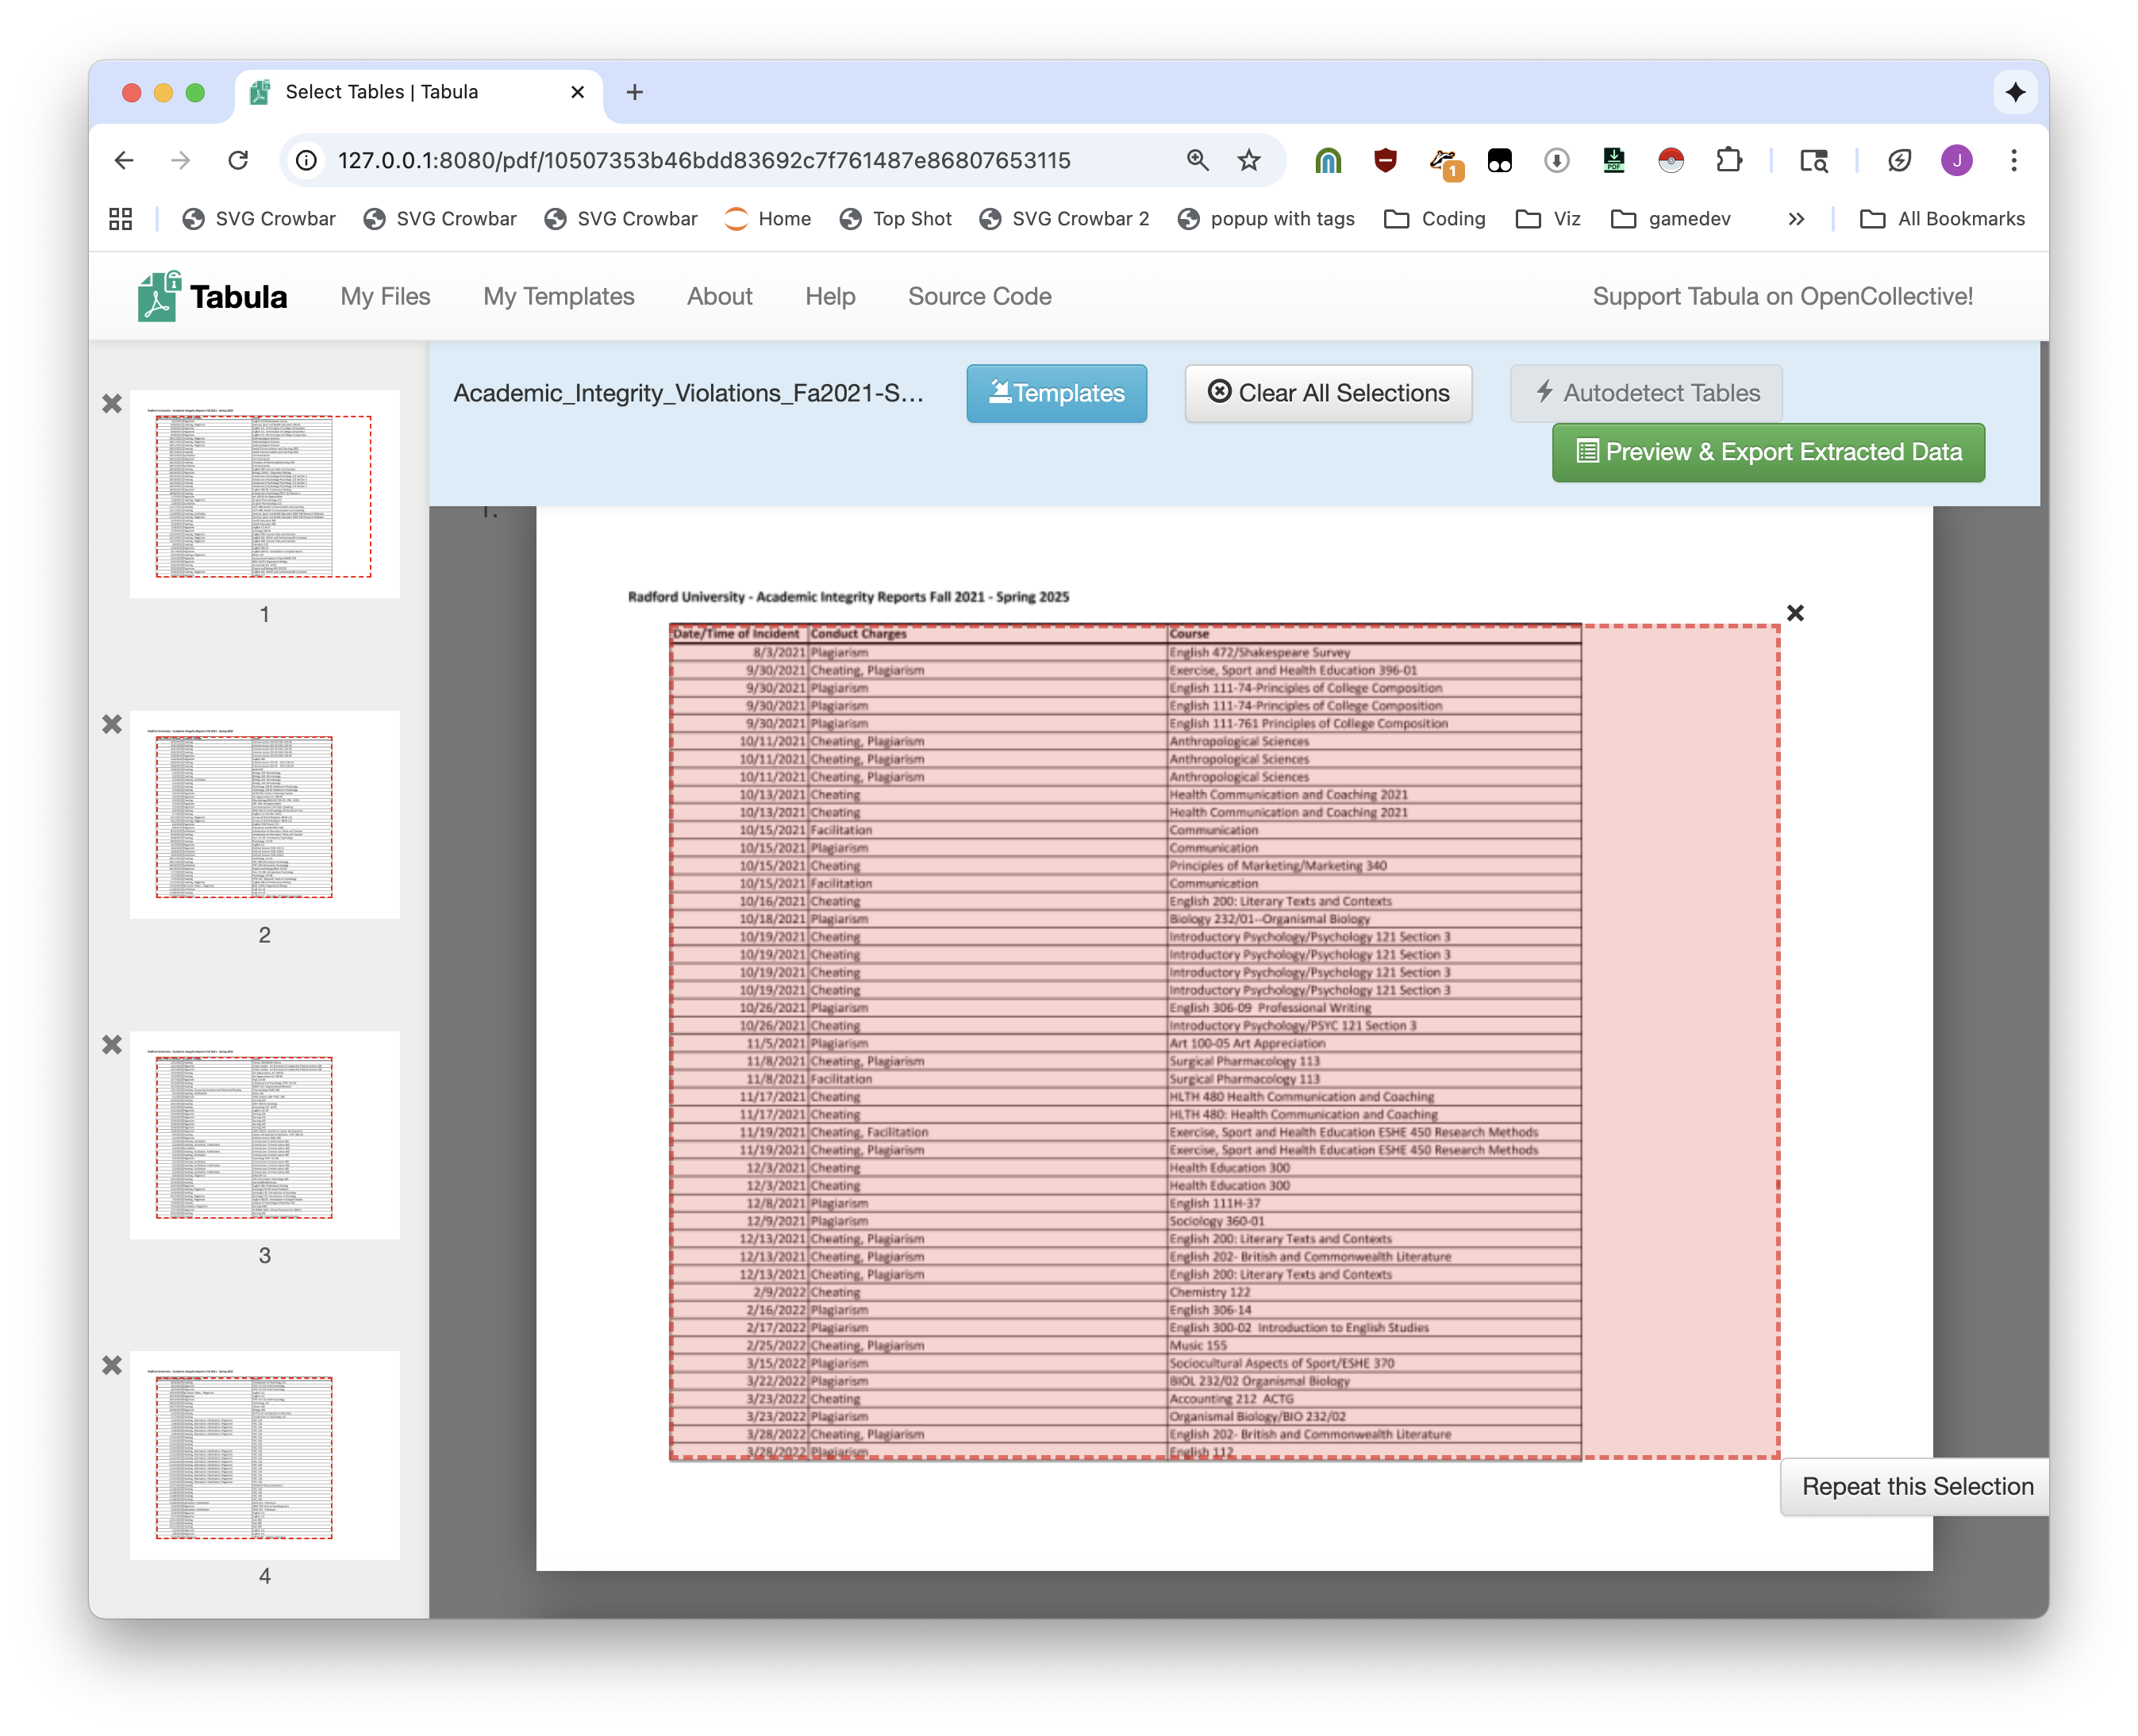

Slide 43
We could use Tabula.
But we want to scale.

Slide 44
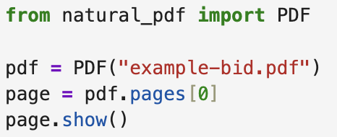
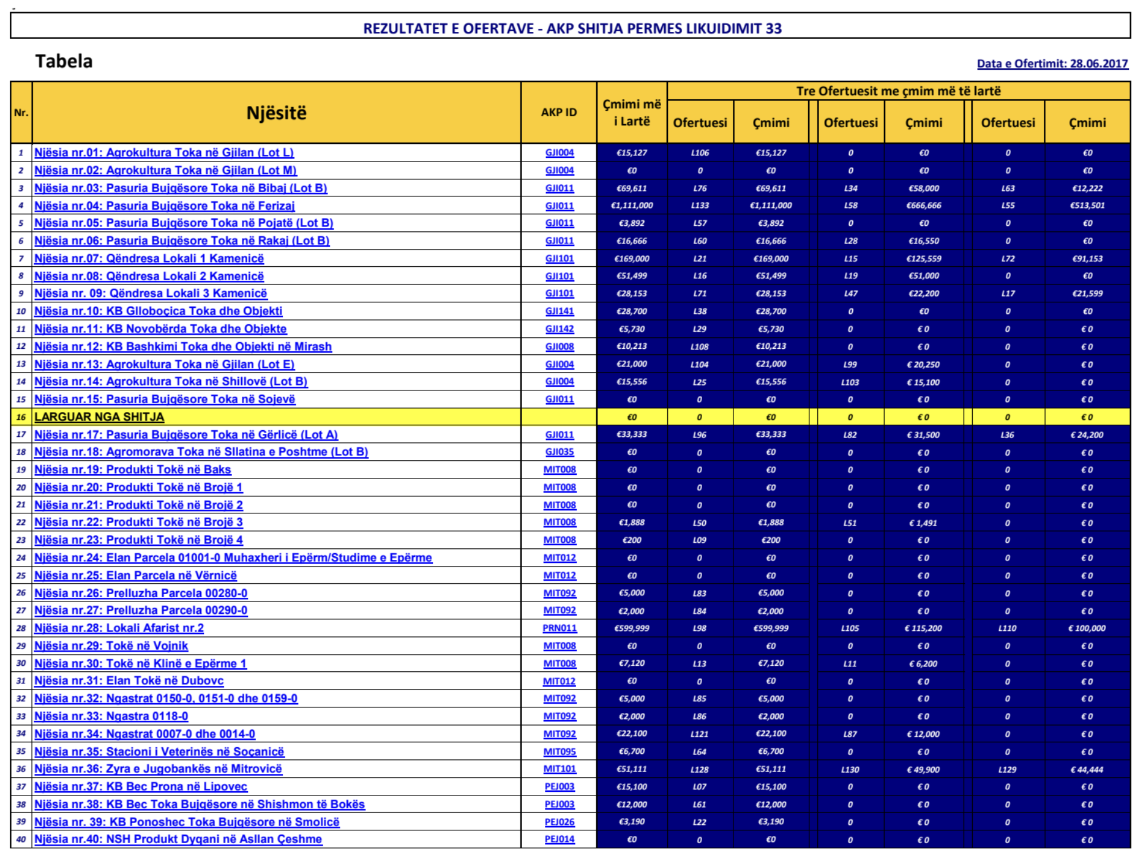


Slide 45


Slide 46


Slide 47







Slide 48




what you’re doing (and how)
your problems
your current code
your request
the output

Slide 49


embrace confusion

Slide 50



Slide 51
When all you have is a hammer everything looks like a nail.
but there are many things that can be solved with a hammer.

Slide 52


Slide 53
I had all of these wild documents, but where did they come from?

Slide 54
This website. It has a bunch of things on it. I had to download them.

Slide 55
Let’s get them ourselves: scraping

Slide 56
Unstructured data is data that isn’t computer-y. We need to make it computer-y. Web pages are the most common version of it.

Slide 57
Here is a page about pokemon

Slide 58
Here is code about pokemon

Slide 59
You like one, your computer likes the other.

Slide 60
Every good story is build on scraping
Examples

Slide 61
You don’t need to learn to code. Maybe you just use a lot of different tools.
I mean it’s better if you can code but for now it’s ok to not code.

Slide 62
PDF downloader

Slide 63
But now it’s on a different page, we can’t just download it. Instead we need to scrape.
Trying to find an extension that does this well is awful.

Slide 64
OK now we got all of the URLs. We could use ChatGPT to filter them, but that’s boring.
Let’s download them all. We’ll use

Slide 65
Download them

Slide 66
Put them into NotebookLM
That’s fine, you can ask questions, get answers, it’s great.

Slide 67
You can scrape more than just web pages, you can also scrape pdfs.
Sorry you have to use code for this and AI is bad at the code.

Slide 68
But you write a little code and then tell ChatGPT to extend it
And then you are doing great

Slide 69
If you want to learn how to do things, here’s how to do things

Slide 70
DONE

